Slide 1

Restriction mapping
and the
Human Genome Project

Slide 2






Human Genome Project
1990: Planning started
1995: International consortium established
2001: Draft of Human Genome produced
2003: Finished sequence announced
2004: Finished sequence published
3,000,000,000 (3 billion) base pairs
20,000 – 25,000 genes

Slide 3
Organising the genome

Slide 4

Bacterial artificial chromosomes

Slide 5
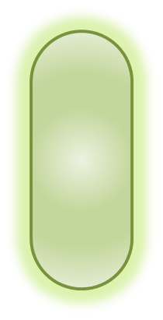
Making a BAC library
Bacterium with BAC of Chr3, end of short arm
Bacterium with BAC of Chr3, short arm above centromere
Bacterium with BAC of Chr3, long arm piece 17

Slide 6

Sequencing from a BAC

Slide 7
Genome sequencing
Sanger sequencing
Developed 1977
Cost: $2.7 billion for human genome
Time: 13 years for human genome
Illumina sequencing
Developed in 2000s
Cost: $5,000 for human genome
Time: 10 days for human genome

Slide 8
Shotgun sequencing

Slide 9
Restriction enzymes | Expected fragment sizes (bp)
BamHI | 5302
PstI | 1427 + 3875
DraI | 2597 + 1148 + 1557
BamHI + PstI | 446 + 1427 + 3429
BamHI + DraI | 1060 + 1537 + 1148 + 1557
PstI + DraI | 1557+ 1506 + 1091 + 336 + 812
BamHI + PstI + DraI | 1557 + 1060 + 446 + 1091 + 336 + 812

Slide 10
PstI + DraI digest
BamHI digest
100 bp ladder
1 Kb ladder
DraI digest
1 Kb ladder
PstI digest
Restriction enzymes | Expected fragment sizes (bp)
BamHI | 5302
PstI | 1427 + 3875
DraI | 2597 + 1148 + 1557
BamHI + PstI | 446 + 1427 + 3429
BamHI + DraI | 1060 + 1537 + 1148 + 1557
PstI + DraI | 1557+ 1506 + 1091 + 336 + 812
BamHI + PstI + DraI | 1557 + 1060 + 446 + 1091 + 336 + 812
10.0
10.0
8.0
8.0
6.0
6.0
5.0
5.0
4.0
4.0
3.0
3.0
2.0
2.0
1.5
1.5
1.0
1.0
The DNA fragments shown in the 100 bp ladder lane are; 1517, 1200, 1000, 900, 800, 700, 600, 500, 400, 300 bp in size (the 100 bp and 200 bp bands have been lost from the bottom of the gel).
0.5
0.5

Slide 11
BamHI + PstI + DraI digest
BamHI + DraI digest
BamHI + PstI digest
100 bp ladder
1 Kb ladder
Restriction enzymes | Expected fragment sizes (bp)
BamHI | 5302
PstI | 1427 + 3875
DraI | 2597 + 1148 + 1557
BamHI + PstI | 446 + 1427 + 3429
BamHI + DraI | 1060 + 1537 + 1148 + 1557
PstI + DraI | 1557+ 1506 + 1091 + 336 + 812
BamHI + PstI + DraI | 1557 + 1060 + 446 + 1091 + 336 + 812
10.0
8.0
6.0
5.0
4.0
3.0
2.0
1.5
1.5
1.2
1.0
1.0
0.9
The DNA fragments shown in the 100 bp ladder lane are; 1517, 1200, 1000, 900, 800, 700, 600, 500, 400, 300 bp in size (the 100 bp and 200 bp bands have been lost from the bottom of the gel).
0.8
0.7
0.6
0.5
0.5
0.4
0.3

Slide 12
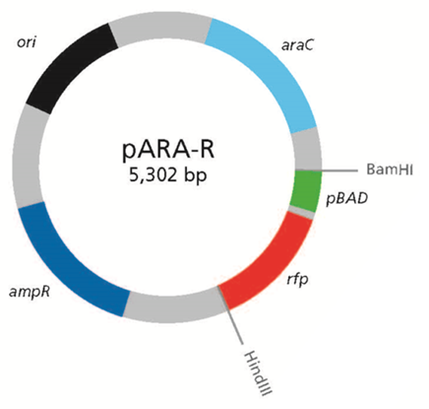
(a)
DraI
DraI
1148 bp
1557 bp
1557 bp
812 bp
DraI
PstI
336 bp
1091 bp
3745 bp
DraI
PstI
DraI
1506 bp

Slide 13
(b)
DraI
336 bp
812 bp
PstI
DraI
PstI
812 bp
336 bp
1557 bp
1557 bp
DraI
DraI
1091 bp
1091 bp
DraI
DraI
PstI
PstI
1506 bp
1506 bp
336 bp
812 bp
DraI
PstI
DraI
PstI
812 bp
336 bp
1557 bp
1557 bp
DraI
DraI
DraI
DraI
1506 bp
1506 bp
1091 bp
1091 bp
PstI
PstI

Slide 14
(a)
DraI
(b)
812 bp
DraI
PstI
1557 bp
1557 bp
DraI
3875 bp
DraI
PstI
1506 bp
(c)
812 bp
DraI
(d)
812 bp
DraI
PstI
PstI
336 bp
1557 bp
336 bp
1557 bp
DraI
1148 bp
DraI
1091 bp
DraI
DraI
2597 bp
PstI
PstI
1506 bp
1506 bp

Slide 15
(a)
812 bp
DraI
(b)
812 bp
DraI
PstI
PstI
336 bp
1557 bp
336 bp
1557 bp
DraI
DraI
1148 bp
1091 bp
1091 bp
DraI
DraI
2597 bp
PstI
PstI
1506 bp
1506 bp
(c)
812 bp
DraI
(d)
812 bp
DraI
PstI
PstI
336 bp
1557 bp
336 bp
1557 bp
DraI
DraI
3429 bp
1091 bp
1091 bp
1537 bp
1060 bp
DraI
446 bp
DraI
PstI
1060 bp
PstI
1060 bp
446 bp
BamHI
446 bp
BamHI

