Slide 1

COURSE 3: Wednesday 12th July 2023
Dr. Phil Smith, MBE
Notes:
Provided by the Advanced Molecular Genetics (AMGen) company to further biotechnology education

Slide 2
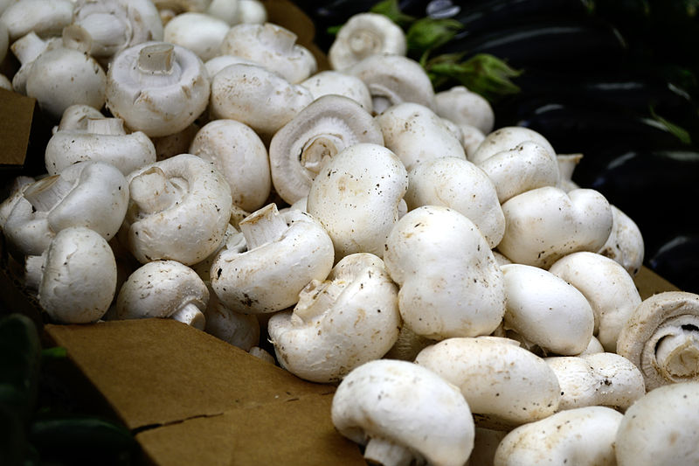
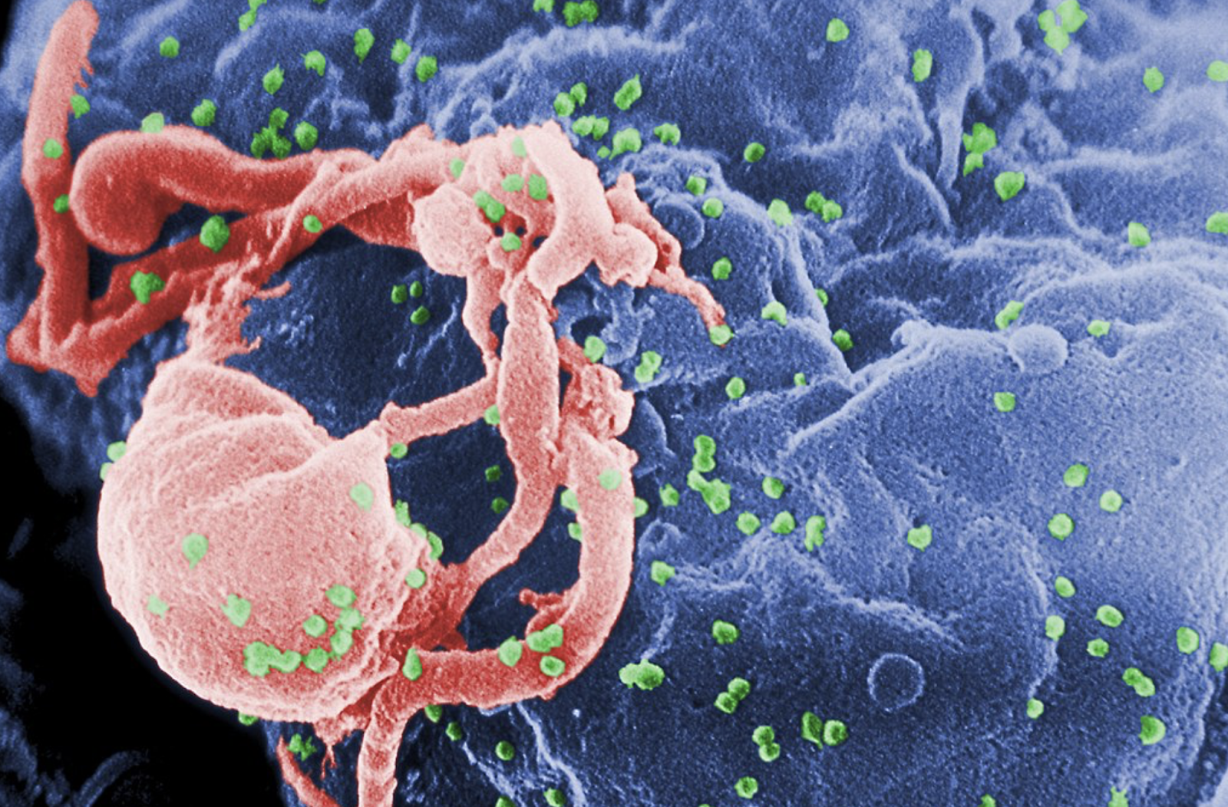
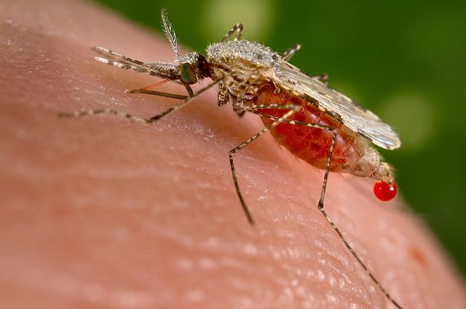
CRISPR-Cas9 genome editing has many different uses
One of the biggest promises of gene editing with CRISPR-Cas9 is to cure genetic diseases by correcting genetic mistakes.
Beyond curing diseases, CRISPR-Cas9 has the potential to improve agriculture, make us immune to infection, and allow for environmental engineering.
An example in agriculture that has already been realized is the non-browning mushroom. The deletion of specific genes (called polyphenol oxidase or PPO genes) creates a non-browning mushroom, which hopefully reduces food waste.
Immunity to infection: Genome editing with CRISPR-Cas9 is presently used to disrupt a gene in human immune cells that produces (or codes for) a protein important for HIV entry. Deleting this gene confers resistance to HIV.
By making CRISPR-Cas9 heritable, scientists are working on using this technology to modify the genome of whole species to eradicate disease. In the case of malaria, one possible strategy of environmental engineering is to ensure that all mosquito offspring will be male to reduce both disease transmission and the overall mosquito population.
Other interesting applications of this groundbreaking gene editing tool include improvement in biofuels, the de-extinction of animal species, and human aging reversal. Keep in mind that many of the promises of CRISPR-Cas9 come with potential perils and ethical complications that need to be analyzed very carefully beforehand. Not everything that is technically doable should also be realized. More information about the promises and perils of CRISPR-Cas9 can be found here.
White mushroom at a supermarket. (Image via Wiki Commons. CC0 1.0 )
HIV (in green) budding from a host cell (in blue). (Image is in the Public Domain via the CDC)
Anopheles stephensi transmits a parasite called Malaria. (Image is in the Public Domain via the CDC)

Slide 3
CRISPR Technology
The application of CRISPR (clustered regularly interspaced short palindromic repeats) for genetic manipulation has revolutionized life science over the past few years (Zhang et al. 2019).
“Like any new technology, CRISPR comes with risks … It was clear early on that there were going to be some real ethical challenges.” Jennifer Doudna, PhD, University of California, Berkeley
After passing through parliament & the Lords, Royal Assent was granted on 23 March 2023 to the Genetic Technology (Precision Breeding) Bill: 2022-23

Slide 4
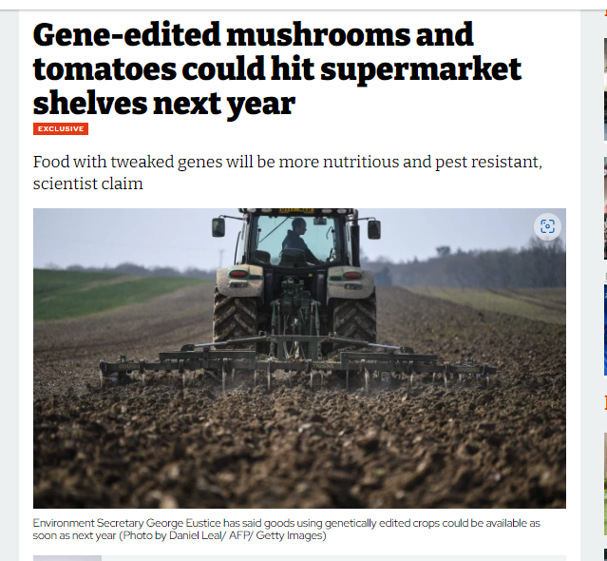


… The gene-edited 'Frankenfoods' that could be on supermarket shelves in the UK as soon as NEXT YEAR
May 27, 2022: https://www.dailymail.co.uk/sciencetech/article-10857053/The-gene-edited-Frankenfoods-hitting-shelves-soon-year.html
May 20, 2022: https://inews.co.uk/news/politics/gene-edited-products-supermarkets-george-eustice-1641349

Slide 5
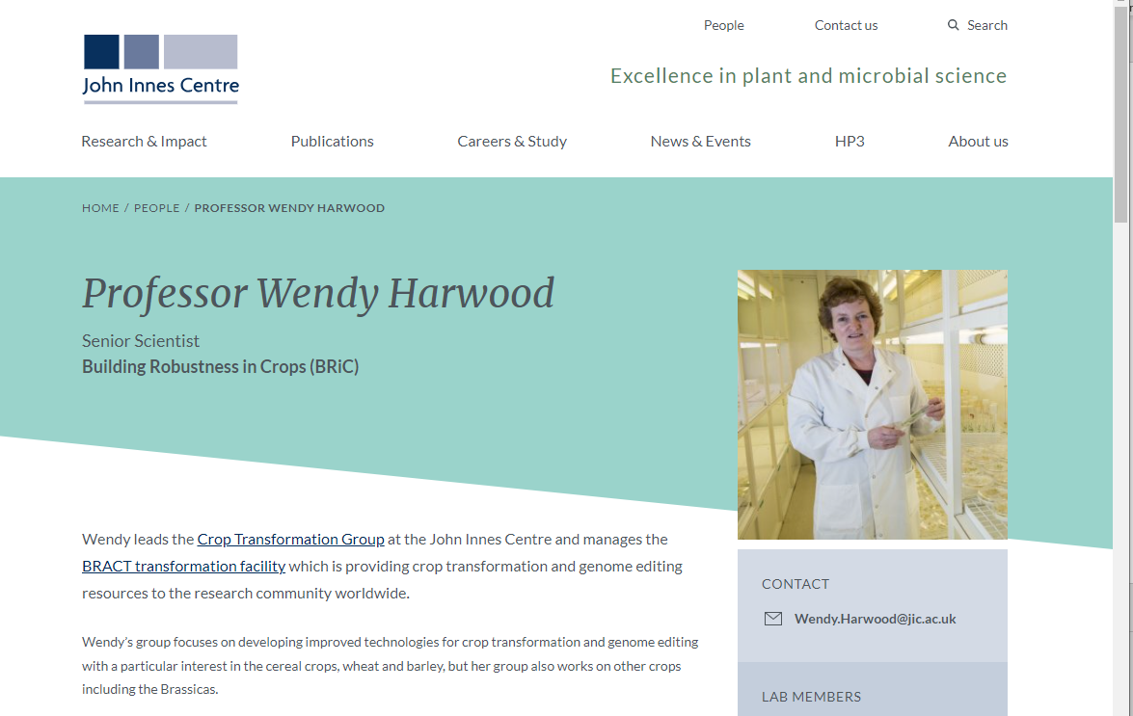
https://www.jic.ac.uk/people/wendy-harwood/
CRISPR gene editing - what is it? - YouTube

Slide 6
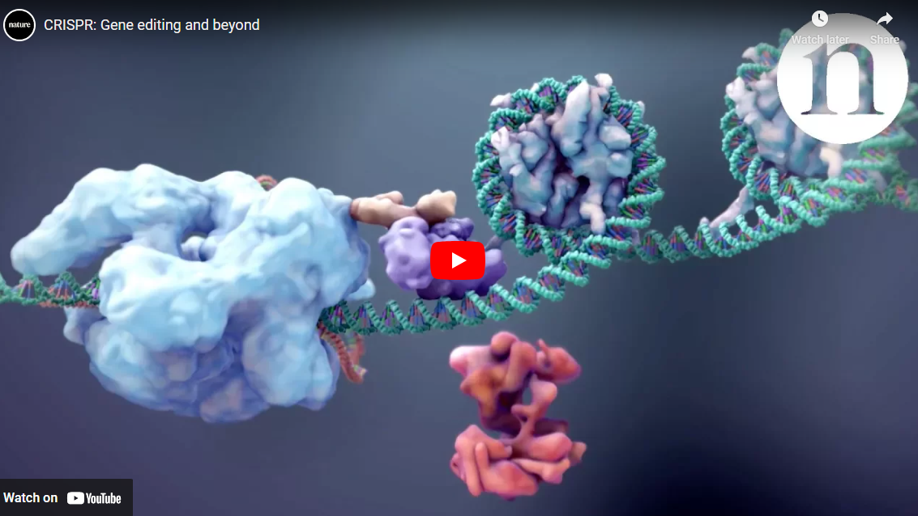
Support materials for CRISPR-teaching (1 of 3)
CRISPR: Gene editing and beyond – YouTube

Slide 7

Support materials for CRISPR-teaching (2 of 3)
www.labxchange.org

Slide 8
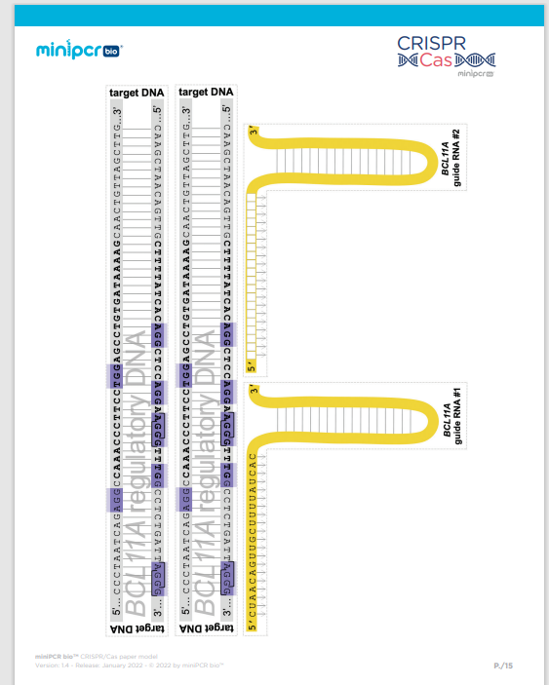
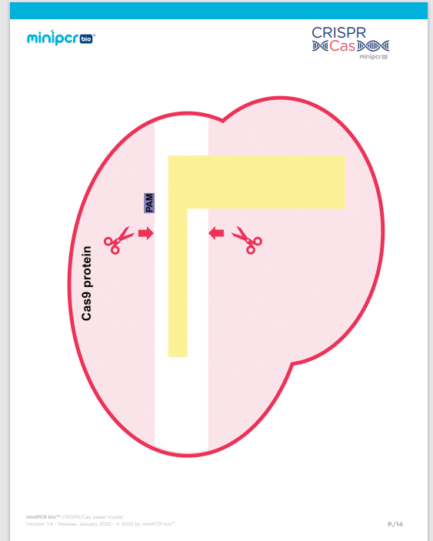
Support materials for CRISPR-teaching (3 of 3)
CRISPR Paper Model - miniPCR bio
There are questions in the worksheets for these activities and minipcr.com have kindly supplied us with the answer sheet!

