Slide 1

Gene editing
Scientific literacy in the field of Biology necessitates understanding the theory (Dobzhansky, 1973)
Public trust in science ultimately … requires ongoing transparency and open discussion (Baltimore et al., 2015)

Slide 2
Gene editing
What is gene editing?
How does CRISPR work?
Why is CRISPR useful?
Bioethical discussion

Slide 3
What is gene editing?
A method of bioengineering.
All gene-editing systems need to be able to:
target a specific DNA sequence
cleave (cut) that DNA sequence
recombine (stick back together) DNA sequences
express the recombined DNA in cells
Recently the ease with which we can edit genes has increased enormously, thanks to advances in bioengineering
Notes:
What is CRISPR / Cas9 system?
How does it work?
See article from me

Slide 4
What is gene editing?
Something we do in the ABE programme:
target a specific DNA sequence
cleave (cut) that DNA sequence
recombine (stick back together) DNA sequences
express the recombined DNA in cells
restriction enzymes
ligation
transformation
This allows us to get bacteria to make a protein (Red Fluorescent Protein) corresponding to a gene (rfp) that we introduce into them.
Notes:
What is CRISPR / Cas9 system?
How does it work?
See article from me

Slide 5
What is gene editing?
So what is the new process that allows us to edit genes, faster, more cheaply and with greater accuracy?
CRISPR Cas9 system
target a specific DNA sequence
cleave (cut) that DNA sequence
recombine (stick back together) DNA sequences
express the recombined DNA in cells
Using guide RNA
Using Cas nuclease
Using
cell’s
own system
Notes:
What is CRISPR / Cas9 system?
How does it work?
See article from me

Slide 6
Gene editing
What is gene editing?
How does CRISPR work?
Why is CRISPR useful?
Bioethical discussion

Slide 7
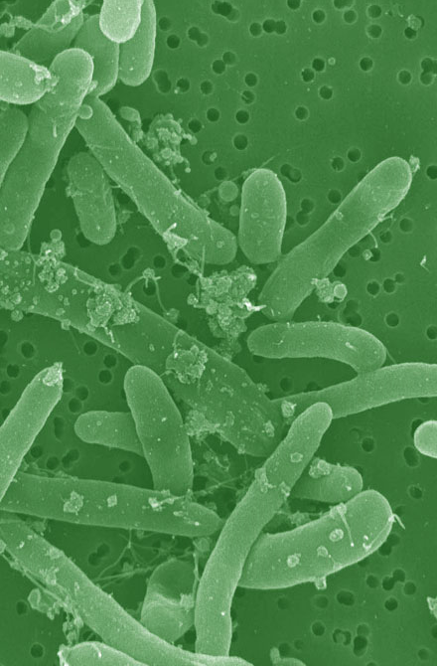
How does CRISPR work?
CRISPR stands for:
Clustered
Regularly
Interspaced
Short
Palindromic
Repeats
It is part of bacteria and Archaea’s adaptive immune system

Slide 8
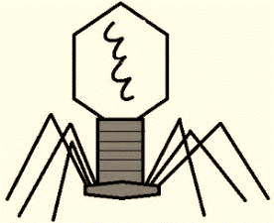
How does CRISPR work?
A bacteria is attacked by a virus, called a bacteriophage

Slide 9
How does CRISPR work?
The bacteriophage inserts its genetic material into the bacteria

Slide 10

How does CRISPR work?
The bacteria must destroy it, using enzymes, before it can hijack the bacteria to make lots more viruses
But rather than just destroy it a small length of the DNA is stored in the bacterial chromosome within the CRISPR region

Slide 11
How does CRISPR work?

Slide 12
How does CRISPR work?
If another bacteriophage the same as the first is encountered…

Slide 13
How does CRISPR work?
… and inserts its genetic material into the bacteria

Slide 14
How does CRISPR work?
… then the response is different
This time DNA from the CRISPR region and the Cas (CRISPR-Associated System) gene are transcribed…

Slide 15
How does CRISPR work?
… and the Cas RNA is translated into a protein, specifically a nuclease

Slide 16
How does CRISPR work?
The RNA guides the nuclease to the familiar DNA…

Slide 17
How does CRISPR work?
…where the Cas nuclease is able to cut the DNA rapidly and efficiently

Slide 18
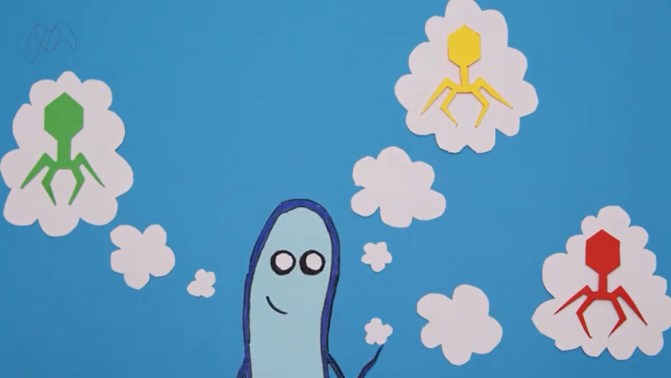
How does CRISPR work?
Notes:
From the Microbiological Society a simple version of where CRISPR-Cas9 came from, what it does and its potential (5 minutes)
https://www.youtube.com/watch?v=52jOEPzhpzc

Slide 19
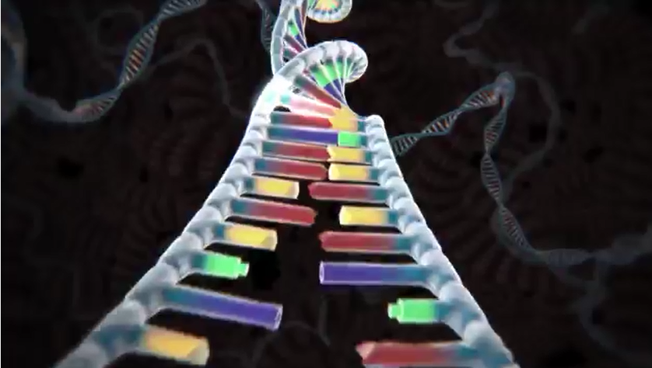
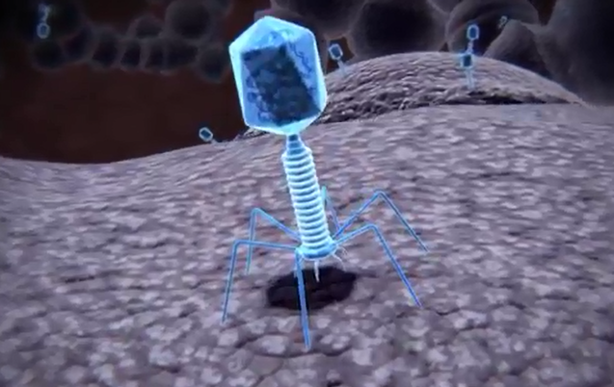
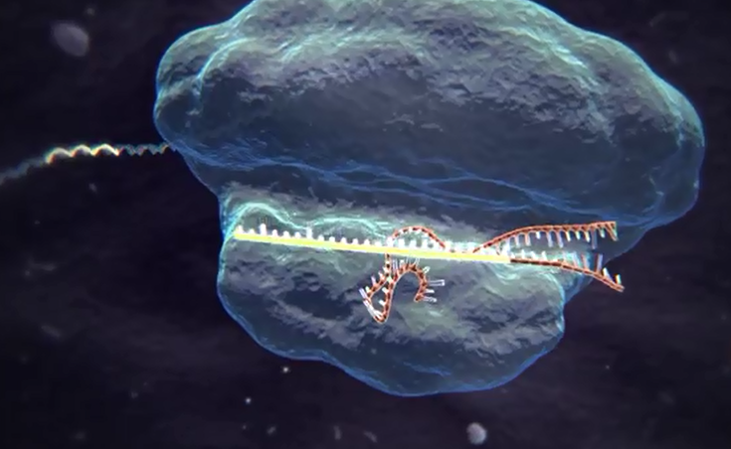
How does CRISPR work?
Editing DNA
Using bacteria’s immune system
To change DNA very specifically using CRISPR Cas9
Notes:
From the McGovern Institute for Brain Research at MIT, a well-presented adventure inside the cell to ‘watch’ the CRISPR-Cas9 system working. More advanced than other video. 4 minutes.
https://www.youtube.com/watch?v=2pp17E4E-O8

Slide 20
Gene editing
What is gene editing?
How does CRISPR work?
Why is CRISPR useful?
Bioethical discussion

Slide 21
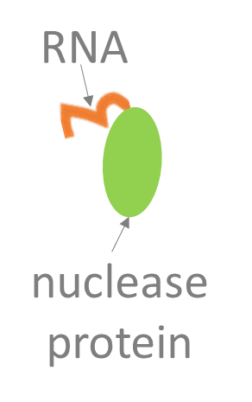
Why is CRISPR useful?
1. The RNA guides a nuclease to cut a specific DNA
sequence
This can be used to ‘knockout’ genes, changing or disabling them so they don’t work and then linking this to loss of function to work out what they do
2. Introduction of an extra section of DNA repair
template, allows the DNA sequence to be
changed in a directed way
This can be used for ‘gene editing’, changing the sequence of a gene in a particular way
For example, it could be used to remove a mutation

Slide 22
Why is CRISPR useful?
1. Engineer a piece of DNA to include sequence for:
guide RNA
Cas nuclease
DNA repair template
2. Introduce this DNA into a cell (often done by transfecting with a plasmid)
3. The cell will internally:
target a specific DNA sequence
cleave (cut) that DNA sequence
recombine (stick back together) DNA sequences
express the recombined DNA in cells
Remember, these are the 4 things needed for gene editing

Slide 23
Gene editing
What is gene editing?
How does CRISPR work?
Why is CRISPR useful?
Bioethical discussion

Slide 24
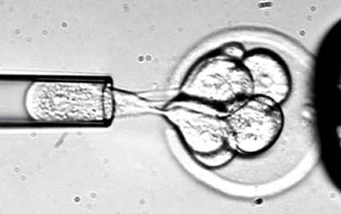
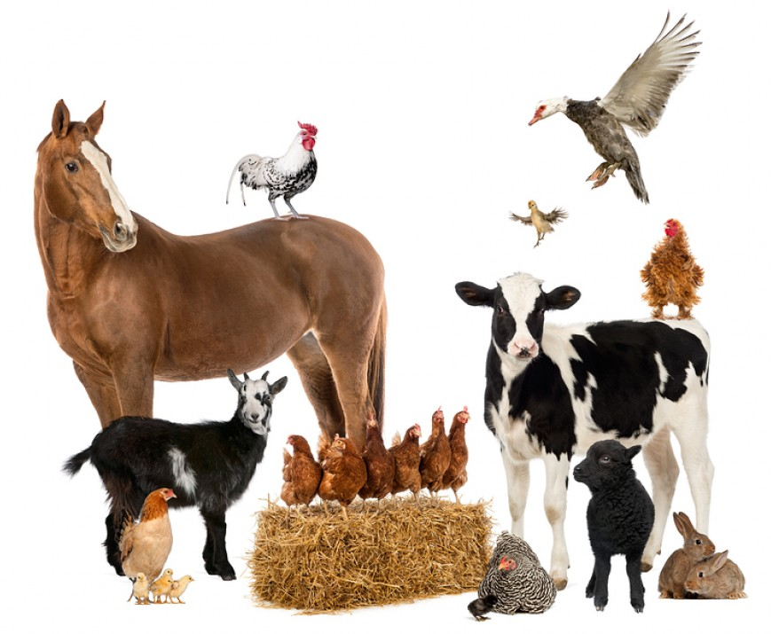

Gene editing: bioethics
Fast
Simple
Cheap
Notes:
Can be used in humans, animals, plants.

Slide 25
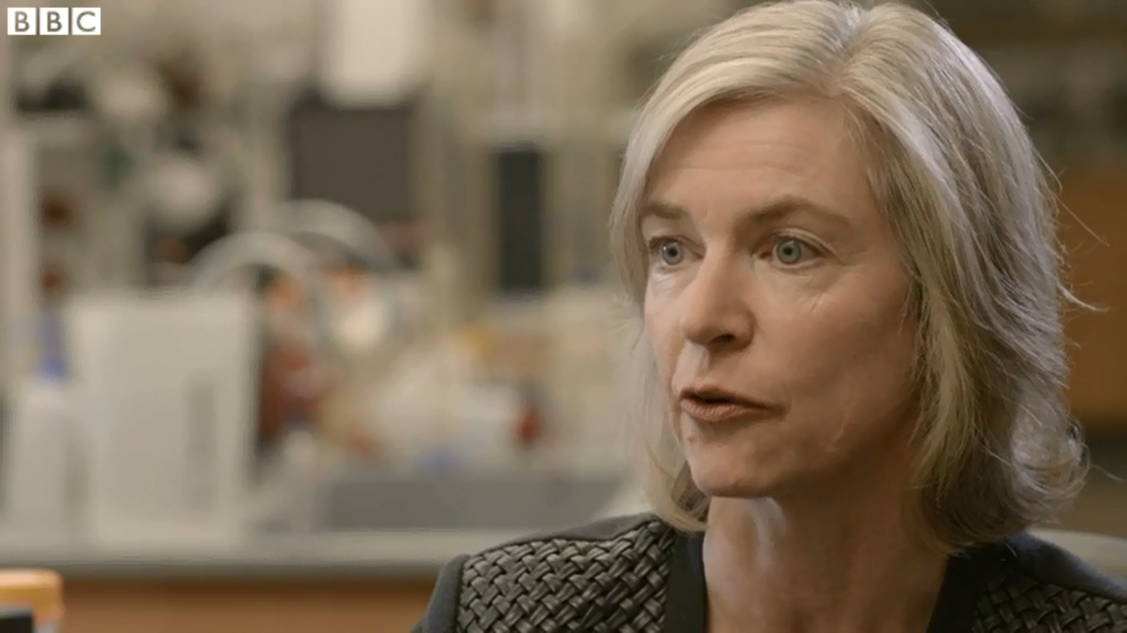
Gene editing: bioethics
Notes:
Interview with BBC and Professor Jennifer Doudna, inventor of the CRISPR ‘gene editing’ technology
Taken from http://www.bbc.co.uk/news/health-36438917
CRISPR 'gene editing' could lead to 'disease cure'
6 June 2016 Last updated at 00:40 BST
A technique that allows scientists to accurately edit and rewrite DNA sequences has been developed in the US.
Professor Jennifer Doudna, who helped discover it, believes the technology could one day lead to a cure for some diseases.
It is known as CRISPR, which is an acronym for clusters of regularly interspaced short palindromic repeats.
Professor Doudna explained to the BBC's health editor Fergus Walsh how it works and what impact it could have.

Slide 26
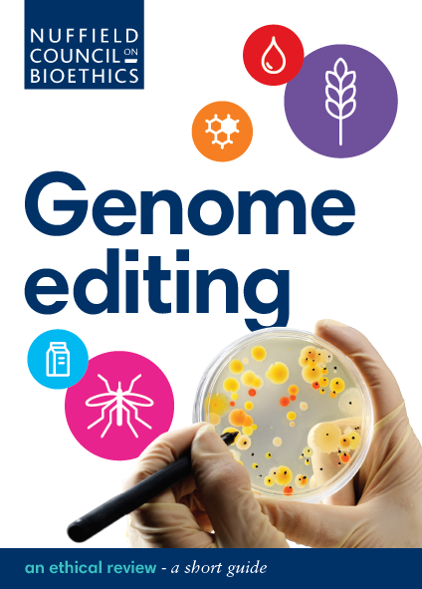
Gene editing: bioethics

Slide 27
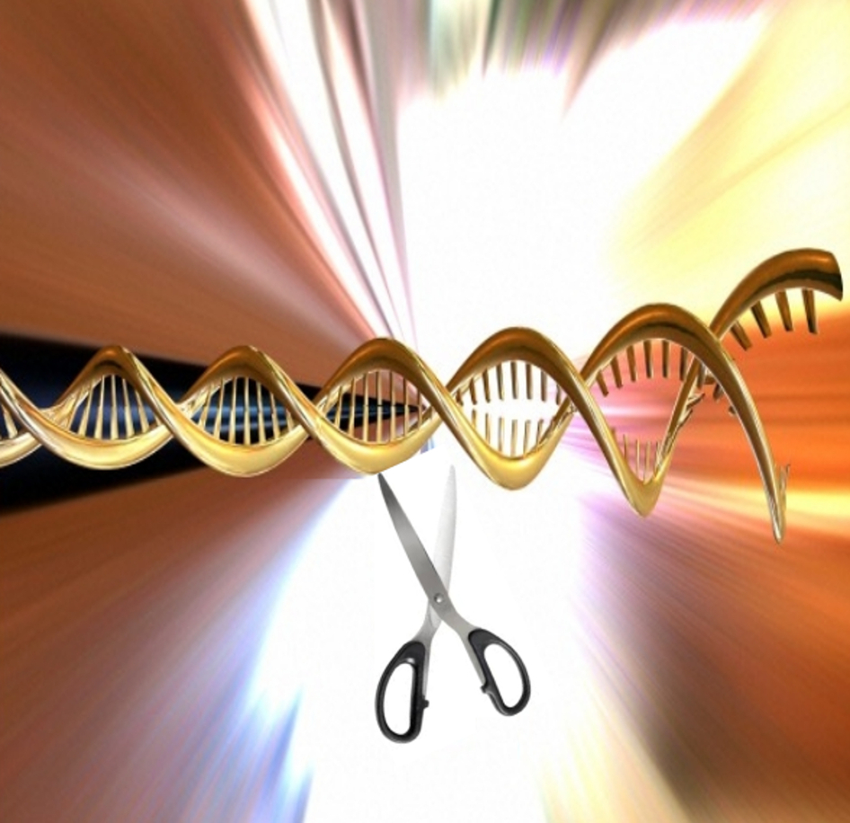
Gene editing: bioethics
Increase ability of farm crops or animals to withstand disease
Develop production of chemicals, pharmaceuticals or ‘third generation’ biofuels
Control insect-bourne diseases, like malaria
Develop xeno-transplantation
Increase food production rates in farm crops or animals
Prevent inheritance of genetic diseases

