Slide 1
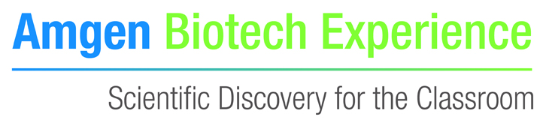
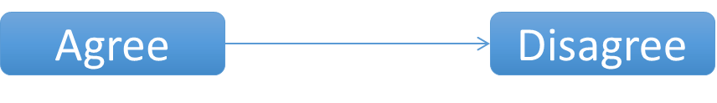
Line of agreement
Line of agreement:
Consider the 6 scenarios
What is your opinion?
You will be asked to show what you think by standing along the line of agreement – you can stand anywhere along the line, not just at the ends
Notes:
From citizen Science project
Lines of agreement
‘Agree’ card placed one end of the room. ‘Disagree’ card placed the other end of the room. Statement cards provided and get arranged along line between the 2 or students decide their opinion and stand somewhere between the 2. Encourages quick thinking. Works well performed after an information gathering session

Slide 2
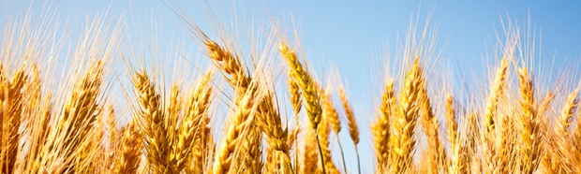
Line of agreement
Scientists should be allowed to…
… use gene editing to develop new plant strains in agriculture, for example disease-resistant strains of wheat.

Slide 3
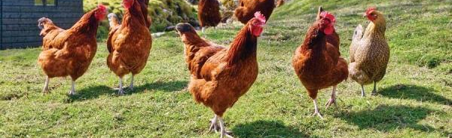
Line of agreement
Scientists should be allowed to…
… use gene editing to create chickens that produce only female offspring to improve the yield of eggs.

Slide 4

Line of agreement
Scientists should be allowed to…
… use gene editing without the need to label farm produce from these organisms as genetically modified.

Slide 5
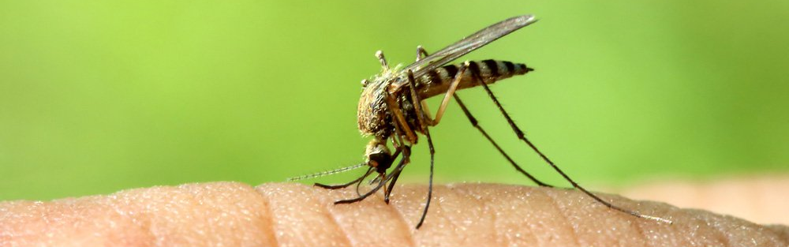
Line of agreement
Scientists should be allowed to…
… use gene editing to control mosquito populations that spread infectious diseases like malaria, using gene drives.

Slide 6
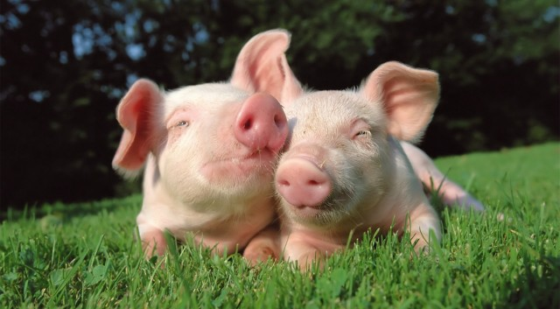
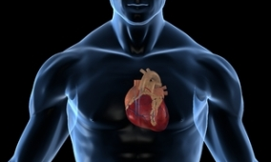
Line of agreement
Scientists should be allowed to…
… use gene editing to alter pig cells to prevent virus transmission, so that organs can be transplanted from pigs to humans (xenotransplantation).

Slide 7
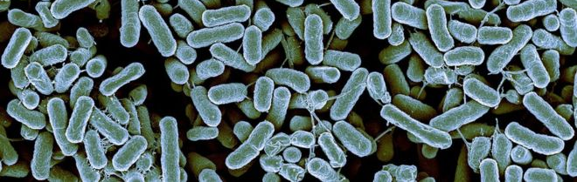
Line of agreement
Scientists should be allowed to…
… use gene editing to produce bacteria intended to cause a disease outbreak.

Slide 8
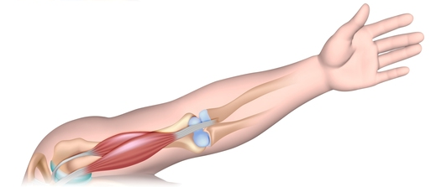
Line of agreement
Scientists should be allowed to…
… use gene editing to correct the genetic mutation that causes muscular dystrophy through gene therapy in children or adults.

Slide 9
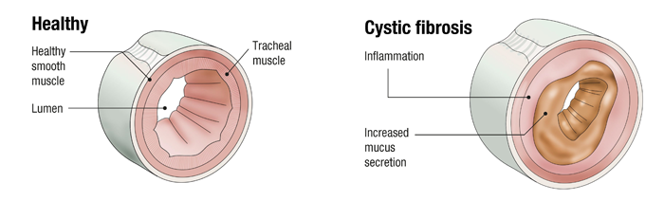
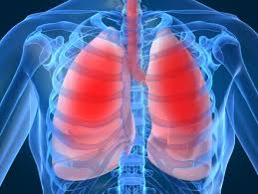
Line of agreement
Scientists should be allowed to…
… use gene editing to correct the genetic mutation for cystic fibrosis in early stage embryos (pre-implantation genetic manipulation).

Slide 10
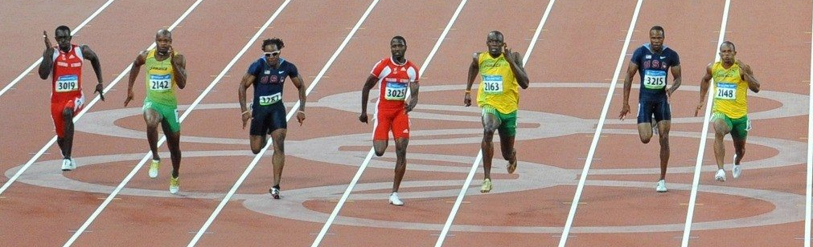
Line of agreement
Scientists should be allowed to…
… use gene editing to enhance
athletic ability in early stage embryos (pre-implantation genetic manipulation).

Slide 11
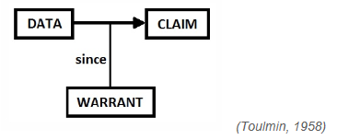
Scientific arguments
Argumentation involves students in discussion and thinking processes which Abrahams and Millar (2008) refer to as having ‘minds on’ the science.
http://www.nuffieldfoundation.org/practical-work-learning/ approach-1-argumentation
Notes:
Argumentation is a fancy word for scientific discussion of issues.
Claim: a conclusion or assertion. (A counter-claim is an opposing conclusion or assertion).
Data: the evidence and facts used to support the claim.
Warrants: statements (rules, principles, etc.) which explain the connections between the data and the claim/conclusion/assertion.
This model represents a relatively simple concept of an argument. By working within this model, students are encouraged to question whether a claim has any merit by considering the evidence, principles and assumptions on which the claim is based.
Here is an example which puts this model into practice.
Chelsea is a better football team than Arsenal [claim]. It has won more football matches at home and away [data] because its players have superior skills [warrant]. (Osborne, Erduran and Simon, 2004b)

Slide 12
Scientific arguments
Claim (assertion):
Data (evidence or facts in support):
Warrants (connecting the evidence and the assertion):
‘Scientists should be allowed to use gene editing to develop new plant strains in agriculture, for example disease-resistant strains of wheat.’
‘Humans have been selecting traits in plants that are beneficial to agriculture (and the health of plants) through selective breeding over many generations without causing problems.’
‘So altering wheat to become disease-resistant using gene editing is a positive development as it mimics the process of selective breeding, but also speeds up the process of introducing positive traits into agriculturally important crops.’
Notes:
Based on your reading, what would a counter-claim be?
Argumentation
Group / pair work: Students use information from their pre-reading to put together 2 claims for and 2 claims against personal genetic testing through companies such as 23&me.
We’ll return to this at the end of the session.
Suspense

Slide 13
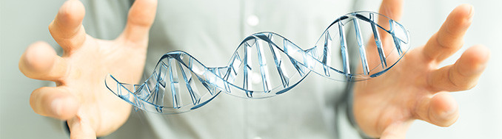
Scientific arguments
Should gene editing be allowed in humans?
Should gene editing be allowed in animals?
How would gene editing affect consumer choice about their food?
How would gene editing affect the environment?
Notes:
Based on your reading, what would a counter-claim be?
Argumentation
Group / pair work: Students use information from their pre-reading to put together 2 claims for and 2 claims against personal genetic testing through companies such as 23&me.
We’ll return to this at the end of the session.
Suspense

Slide 14
Gene editing: bioethics
There is an urgent need for open discussion of the merits and risks of human genome modification by a broad cohort of scientists, clinicians, social scientists, the general public, and relevant public entities and interest groups
(Baltimore et al., 2015)

Slide 15
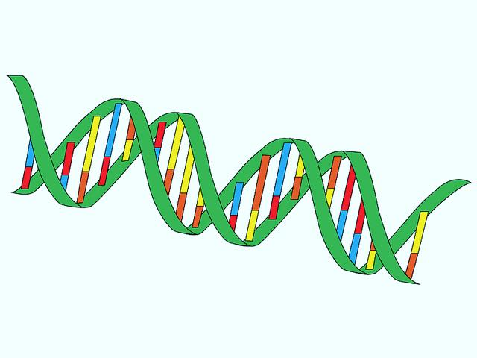
Gene editing: bioethics
In 1975 concerns about safety led scientists from around the world to halt experiments combining DNA from different organisms
They held the Asilomar conference on recombinant DNA in California
Biologists, lawyers and physicians assembled and discussed guidelines to ensure the safety of recombinant DNA technology

Slide 16
Gene editing: bioethics
In January 2015 concerns about ‘unknown risks to human health and well-being’ from our increased ability to edit genes led many scientists from around the world to halt experiments on germline gene modification
They held the IGI Forum on Bioethics in California
People from a multitude of backgrounds assembled and discussed guidelines to ensure that maniulating genomes can be performed safety

Slide 17
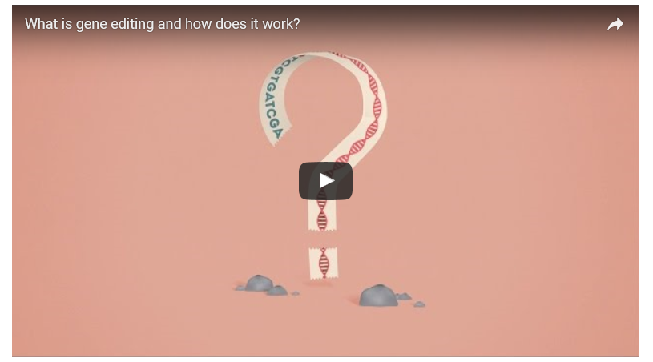
Gene editing: bioethics
Notes:
From the Wellcome Trust a 4 min 22sec video clip explaining how gene editing allows scientists to change gene sequences by adding, replacing or removing sections of DNA.
Possibilities, advantages and disadvantages of gene editing
https://bigpictureeducation.com/what-gene-editing-and-how-does-it-work?utm_campaign=552352_Big%20Picture%20newsletter%2018%20October&utm_medium=email&utm_source=dotmailer&dm_i=2PXJ,BU74,3WOAP1,15PET,1

Slide 18
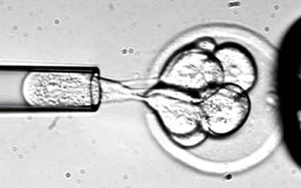
Gene editing: bioethics
Bioengineering embryonic stem cells will change all of that person’s DNA, and the DNA that they pass onto their offspring
In April 2015, Chinese scientists reported results of an attempt to alter the DNA of non-viable human embryos using CRISPR to correct a mutation for beta thalassemia.
There was outcry from many scientists.
However, in April 2016 Chinese scientists again attempted to alter the DNA of non-viable human embryos using CRISPR, this time changing the CCR5 gene to make the embryo HIV resistant.
Notes:
Liang P, Xu Y, Zhang X, Ding C, Huang R, Zhang Z, Lv J, Xie X, Chen Y, Li Y, Sun Y, Bai Y, Songyang Z, Ma W, Zhou C, Huang J (May 2015). "CRISPR/Cas9-mediated gene editing in human tripronuclear zygotes". Protein & Cell. 6 (5): 363–72.

Slide 19
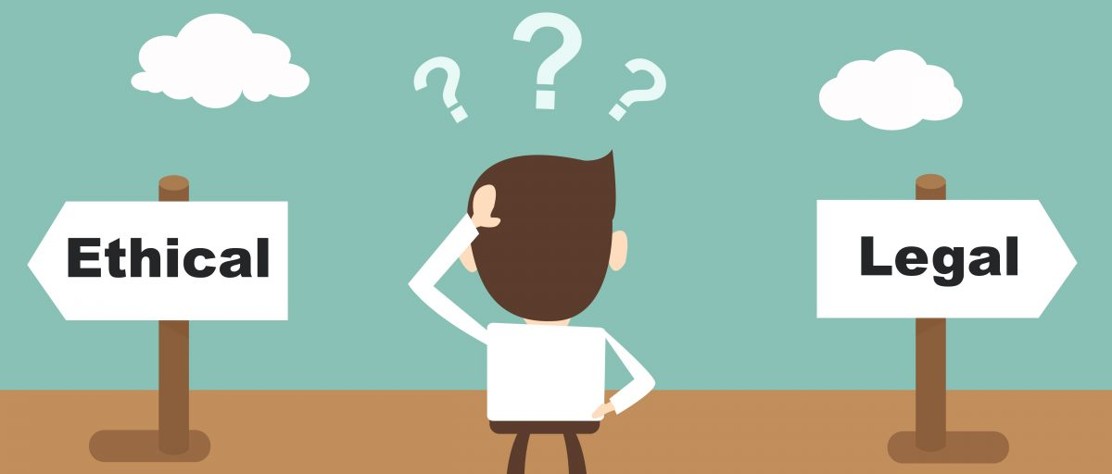
Gene editing: bioethics
Experts are divided on the implications and permitted applications of the new gene editing technologies
There are no correct answers in this field
Consideration of the legal and ethical issues is struggling to keep up with the pace of scientific developments
Your opinions matter
Notes:
Liang P, Xu Y, Zhang X, Ding C, Huang R, Zhang Z, Lv J, Xie X, Chen Y, Li Y, Sun Y, Bai Y, Songyang Z, Ma W, Zhou C, Huang J (May 2015). "CRISPR/Cas9-mediated gene editing in human tripronuclear zygotes". Protein & Cell. 6 (5): 363–72.

Slide 20
Gene editing: discussion
Discussions are held aiming:
  “to improve knowledge understanding,
  to contribute to citizenship education,
  to help students to make informed decisions,
  to empower them to participate in debates,
  to help them to be able to deal with complexity, and
  to understand better the nature of science”
  (Simonneaux & Simonneaux, 2008)
Notes:
One aim of Science teaching is, of course, to introduce scientific theories and concepts to the next generation of scientists. However, an even more important aim of teaching Science is generally to improve scientific literacy for personal use and for engagement as citizens affected by our societal choices of how to use Science and associated technologies. Scientific debate in class is one way to encourage development of this scientific literacy and potentially improve citizen engagement with scientific issues in the future
Page 181 of Simonneaux and Simonneaux (2008) article quoted.

Slide 21
Gene editing: discussion
A fisherman’s circle
A
E
1
B
5
2
4
3
D
C
Notes:
One aim of Science teaching is, of course, to introduce scientific theories and concepts to the next generation of scientists. However, an even more important aim of teaching Science is generally to improve scientific literacy for personal use and for engagement as citizens affected by our societal choices of how to use Science and associated technologies. Scientific debate in class is one way to encourage development of this scientific literacy and potentially improve citizen engagement with scientific issues in the future
Page 181 of Simonneaux and Simonneaux (2008) article quoted.

Slide 22
Gene editing: discussion
A fisherman’s circle
E
D
1
A
5
2
4
3
C
B
Notes:
One aim of Science teaching is, of course, to introduce scientific theories and concepts to the next generation of scientists. However, an even more important aim of teaching Science is generally to improve scientific literacy for personal use and for engagement as citizens affected by our societal choices of how to use Science and associated technologies. Scientific debate in class is one way to encourage development of this scientific literacy and potentially improve citizen engagement with scientific issues in the future
Page 181 of Simonneaux and Simonneaux (2008) article quoted.

Slide 23
Gene editing: discussion
A fisherman’s circle
D
C
1
E
5
2
4
3
B
A
Notes:
One aim of Science teaching is, of course, to introduce scientific theories and concepts to the next generation of scientists. However, an even more important aim of teaching Science is generally to improve scientific literacy for personal use and for engagement as citizens affected by our societal choices of how to use Science and associated technologies. Scientific debate in class is one way to encourage development of this scientific literacy and potentially improve citizen engagement with scientific issues in the future
Page 181 of Simonneaux and Simonneaux (2008) article quoted.

Slide 24
Gene editing: discussion
A fisherman’s circle
C
B
1
D
5
2
4
3
A
E
Notes:
One aim of Science teaching is, of course, to introduce scientific theories and concepts to the next generation of scientists. However, an even more important aim of teaching Science is generally to improve scientific literacy for personal use and for engagement as citizens affected by our societal choices of how to use Science and associated technologies. Scientific debate in class is one way to encourage development of this scientific literacy and potentially improve citizen engagement with scientific issues in the future
Page 181 of Simonneaux and Simonneaux (2008) article quoted.

Slide 25
Gene editing: discussion
A fisherman’s circle
B
A
1
C
5
2
4
3
E
D
Notes:
One aim of Science teaching is, of course, to introduce scientific theories and concepts to the next generation of scientists. However, an even more important aim of teaching Science is generally to improve scientific literacy for personal use and for engagement as citizens affected by our societal choices of how to use Science and associated technologies. Scientific debate in class is one way to encourage development of this scientific literacy and potentially improve citizen engagement with scientific issues in the future
Page 181 of Simonneaux and Simonneaux (2008) article quoted.

Slide 26
Line of agreement
Line of agreement:
Consider the 6 scenarios
What is your opinion?
You will be asked to show what you think by standing along the line of agreement – you can stand anywhere along the line, not just at the ends
Notes:
From citizen Science project
Lines of agreement
‘Agree’ card placed one end of the room. ‘Disagree’ card placed the other end of the room. Statement cards provided and get arranged along line between the 2 or students decide their opinion and stand somewhere between the 2. Encourages quick thinking. Works well performed after an information gathering session

Slide 27
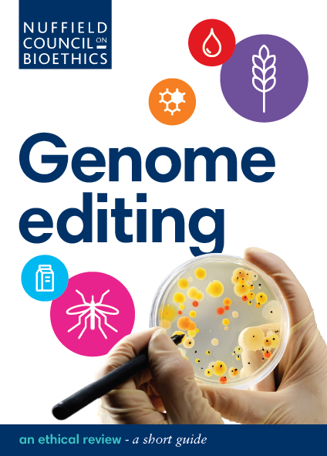
Gene editing: bioethics
Write a letter with your reasoned opinions on gene editing
These letters will be sent to the Nuffield Council on Bioethics
Don’t forget to:
Introduce your question
Provide your reasoned arguments
Summarise your opinion

Slide 28

Gene editing: bioethics
Introduction: Is it clear what question is being addressed?
Body: Is there at least one assertion, supported by evidence and joined into a warrant?
Body: Are references provided to support the data?
Body: Are there warrants for and against the question?
Conclusion: Are there references to the warrants, with the opinion of the writer made clear?

Slide 29


Slide 30
Gene editing
What is gene editing?
How does CRISPR work?
Why is CRISPR useful?
Bioethical discussion

