Slide 1

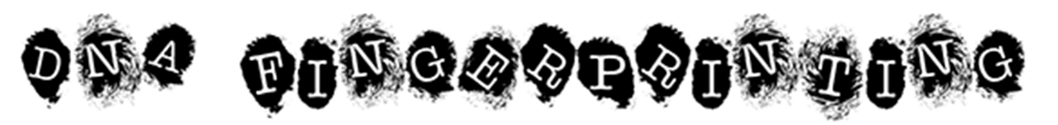
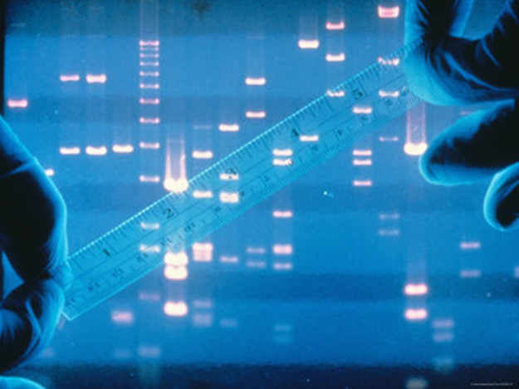
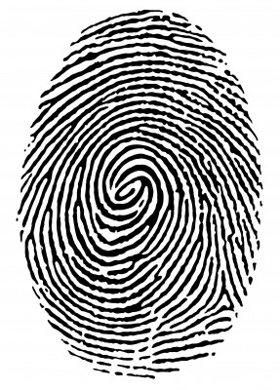
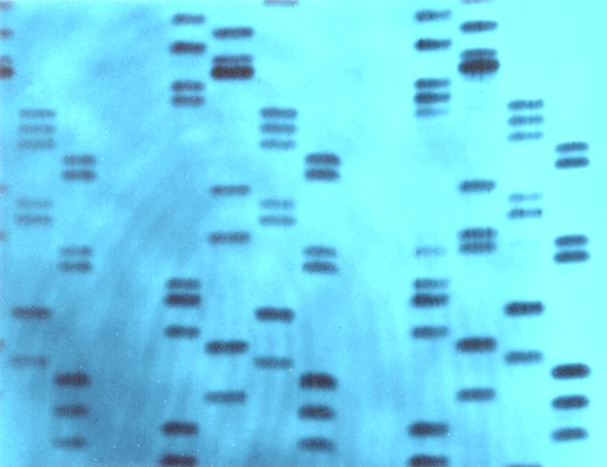
DNA identifies you
Notes:
Crime Scene Analysis uses a range of techniques. Uniformed officers secure the area and dogs sniff for clues. Another technique ‘DNA fingerprinting’ is now common too – scientists in biohazard suits to prevent contamination, analysing every little detail for DNA evidence that can point to a suspect and, hopefully, close the case.
The method of DNA fingerprinting, stems largely from the work of one man – Professor Sir Alec Jeffreys. It was he who developed techniques to use DNA to identify people.
This morning I’d like to spend a few minutes telling you a little bit about him…

Slide 2


Alec Jeffreys
Notes:
Alec was born, and spent the first 6 years of his life in Oxford, before moving with his family to Luton.
When he was 8, his father gave him a Chemistry set. He loved it and tried lots of reactions, as well as buying other chemicals to add to it, like the sulphuric acid, which splashed out during one of his more explosive reactions and gave him a small scar on his chin.
However, his curiosity and inventiveness were undaunted. His father bought him a much-loved microscope and he saved up for a dissecting kit. He was encouraged in his hobby of insect dissection, although when he found a dead cat and brought it home in his bag and dissected it on the dining room table, stinking out the house when he ruptured its intestines, he recalls his parents were not best pleased!
His interest in and love of Science, led him back to Oxford to study at University, and later to work at the University of Leicester.

Slide 3

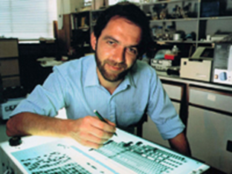
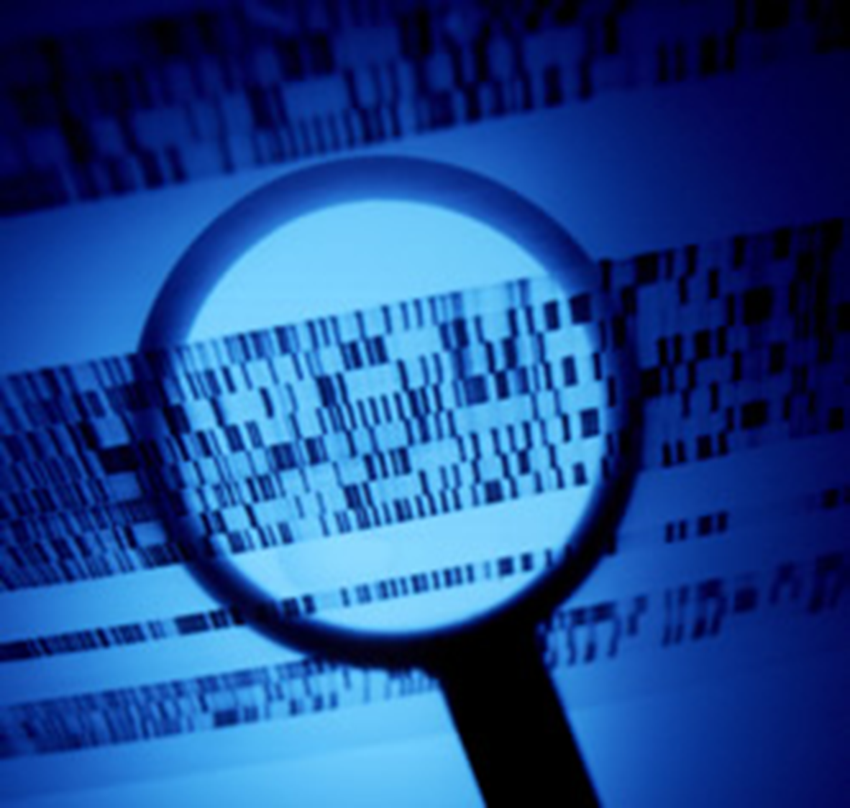
Alec Jeffreys
DNA fingerprinting
Notes:
In 1984, whilst at Leicester, Alec worked in the field of genetics – a very new science in those days.
One day, during an experiment, he found that there were similarities and differences between the DNA of a lab technician's family. Further experiments led him to realize that differences in an individual's DNA could be used to identify them – DNA fingerprinting had been invented.

Slide 4
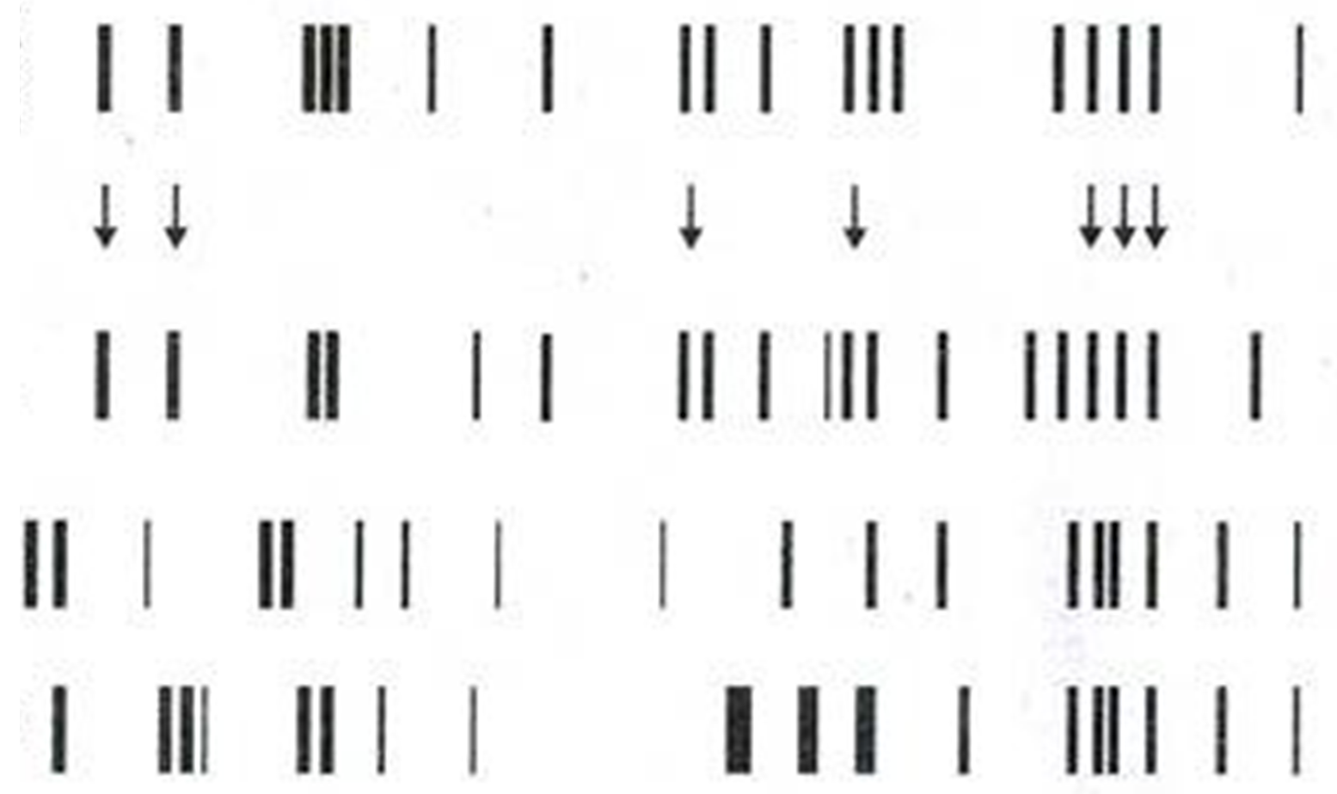
DNA fingerprinting
Scene of
Crime DNA
Suspect 1
Suspect 2
Suspect 3
Notes:
The method of DNA fingerprinting involves:
Taking DNA from a sample
Cutting it up
Separating the pieces of DNA by size
Comparing the ‘DNA fingerprints’
A reasonably simple technique the DNA fingerprint would look like this.
This is a DNA fingerprint from a Crime Scene.
The Scene of Crime DNA is at the top of the image: big bits close to the writing and small bits further away.
DNA from suspects 1, 2 and 3 are shown lower down the image.
Can anyone see which of the suspects DNA fingerprint showed similarities to the DNA fingerprint from the Scene of Crime? (1)

Slide 5
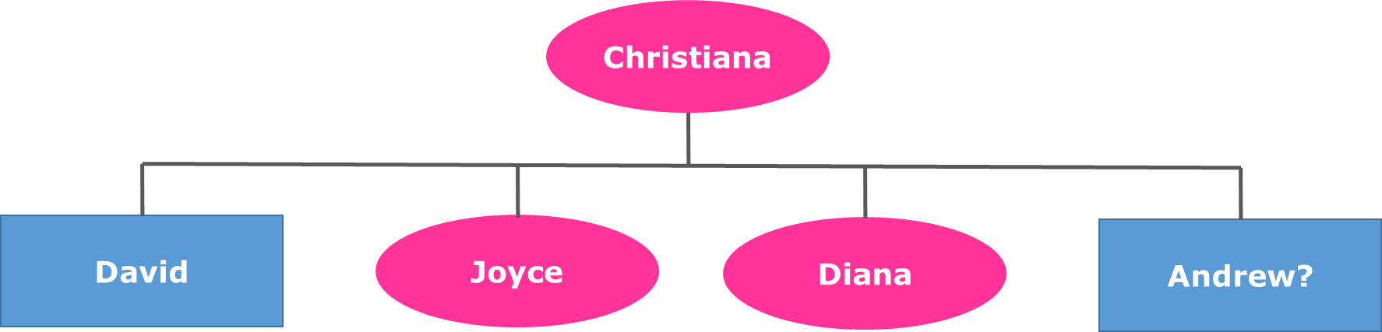

DNA fingerprinting
Reuniting families
Notes:
The new technique had to prove its usefulness though. The first practical application of ‘DNA fingerprinting’ was not at a crime scene, but in a case of immigration.
Christiana, mother to David, Joyce and Diana, lived in England. Her estranged husband lived in Ghana. In 1985, a 13 year old boy called Andrew was sent from Ghana by his father to be reunited with his mother – Christiana.
Immigration officials held Andrew at Heathrow airport, claiming his passport was forged and he did not have the right to remain in the UK. While awaiting deportation The Law Centre representing Andrew read about ‘DNA fingerprinting’, contacted Alec Jeffreys and asked him to help. By comparing the DNA of Andrew to Christiana, David, Joyce and Diana Alec Jeffreys found the odds of Christiana being the mother were 600,000 to 1 for.
After DNA identified him Andrew was not deported but remained in the UK reunited with his mother.

Slide 6
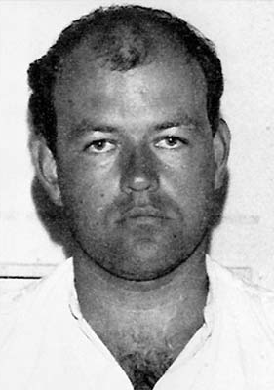
DNA fingerprinting
Colin Pitchfork
Murder conviction
Notes:
It wasn’t until 3 years later, in 1988, that the first murder conviction was made based on DNA fingerprinting.
2 schoolgirls had been assaulted and murdered. A local man had been arrested and charged. Asked to help, Alec Jeffreys found that the local man’s DNA did not match that found on the schoolgirl’s bodies. The local man was exonerated – released with apologies.
4,000 blood and saliva samples were taken from men in the surrounding villages, who did not have an alibi for the time of the murders.
Then by chance a woman overheard her colleague gloating that he had earnt some money providing samples for a friend: Colin Pitchfork. She informed the Police, who arrested and took samples from him. The samples matched the DNA fingerprint found at the crime scenes. In 1988 Colin Pitchfork was sentenced to life imprisonment for the murders.

Slide 7
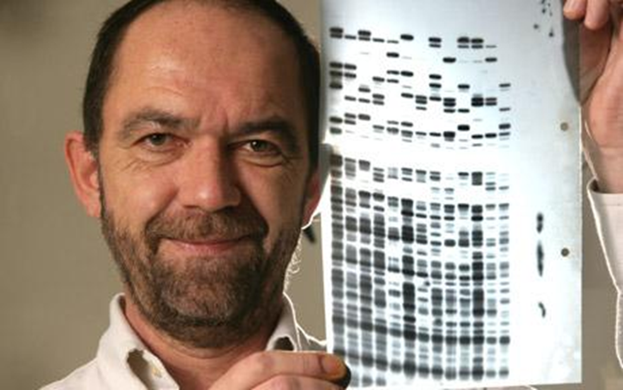
DNA fingerprinting
Alec Jeffreys: identifying through DNA
Notes:
Nowadays, Alec Jeffreys’ method of DNA fingerprinting is frequently used worldwide to:
Identify parents and children
Identify animal pedigree (for conservation / breeding programmes)
Identify criminals
Many countries, including the DNA have National DNA databases of people’s DNA fingerprints.

Slide 8

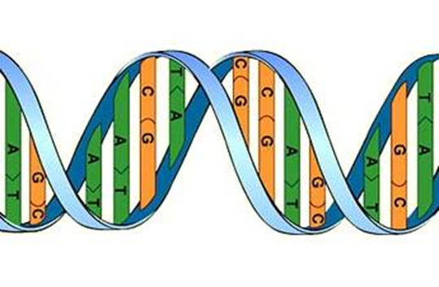
DNA fingerprinting
DNA identifies you.
Your actions define you.
Notes:
The Science of genetics, allows us to be identified by our DNA. However, DNA is a string of chemicals and there is always more to a person than just a series of chemicals. Our DNA can identify us, but our actions define us.
We are born with a DNA profile, but it is up to us to use the abilities and talent that we are born with well – hopefully for the greater good. Alec Jeffreys applied himself to an area he felt passionately about (Science) and used his abilities to help develop our knowledge and use of genetics.
Leave you with the thought….
If DNA can identify you, but your actions define you…
What do your actions say about you?
What are your talents and abilities?
How could you use these for the greater good of humanity?

Slide 9
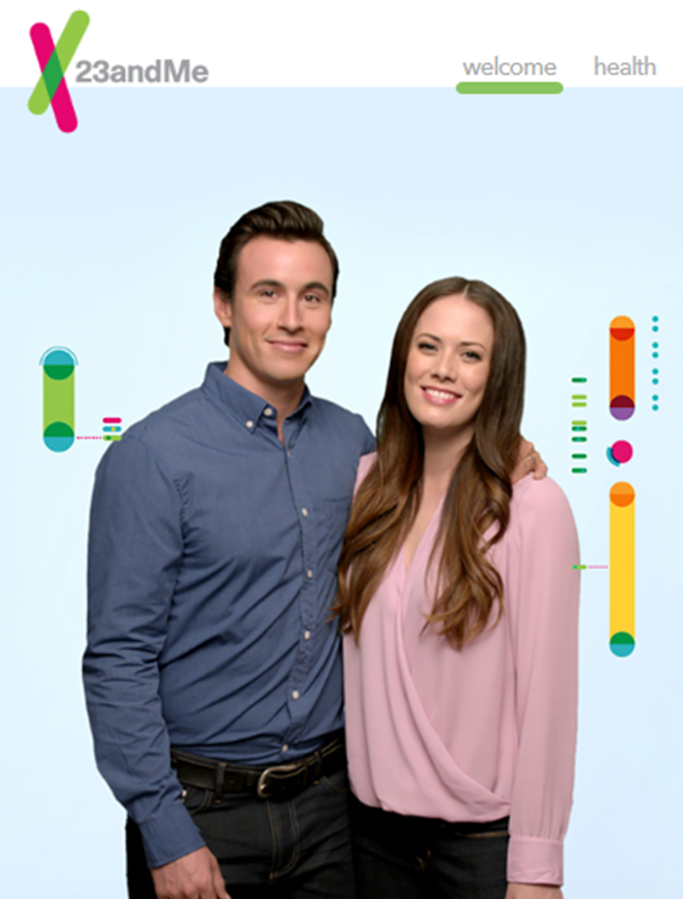
DNA fingerprinting
DNA identifies you.
What can your DNA tell you?
Notes:
The Science of genetics, allows us to be identified by our DNA.
Now you can learn more about your DNA from direct-to-consumer genetic testing from 23&me.
But:
How much does it really tell you?
What do you want to know about health implications when there is no treatment?
How does it affect insurance?
What about the privacy of your data?
(NOTE: 23&me is banned by the FDA in the USA because they are concerned about the accuracy of the 23&me tests. It is run by the co-founder of Google’s wife (Anne Wojcicki, married to Sergei Brin) and when you send off a sample you agree that the health data that you provide, alongside the DNA that they extract from your sample can be used for research purposes – Privacy of data is not ensured. In fact 23&me reserves the right to use your personal information to try and sell you products and services. Any pertinent health related information you find, must be declared on insurance forms.)
23andMe warns on its website, “Genetic Information that you share with others could be used against your interests. You should be careful about sharing your Genetic Information with others.” I would suggest that this should include 23&e themselves!

