Slide 1

Extending DNA activities
Direct to consumer genetic testing
Flipped learning, argumentation
BRCA Case study
Narrative, Mendelian and molecular genetic links
Breast cancer genes: genetic testing, bioinformatics and implications
Careers involved in genetic testing, bioinformatics exercise

Slide 2
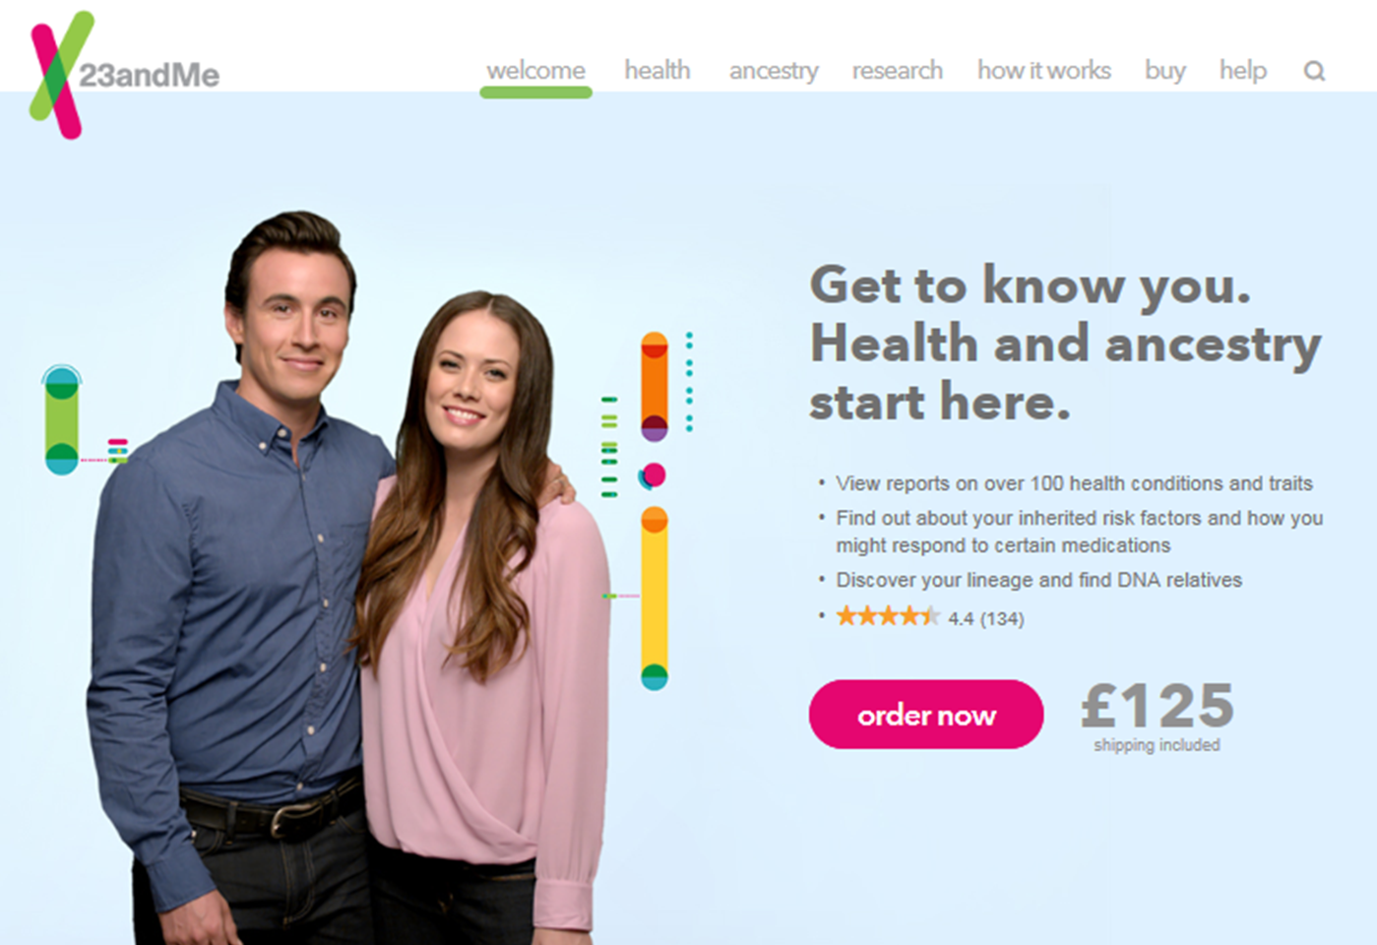
Starter: 23&me
https://www.23andme.com/en-gb/
Notes:
Companies like 23&me are able to scan our individual genetic make-up. They offer direct to consumer genetic testing. Who wouldn’t want to understand the information contained in their DNA? But is this an appropriate way to try and understand it?
Flipped learning: pre-reading of 3 articles (from Guardian, On-line ‘medicine think’, and Scientific American)
Relevance: technology available today!

Slide 3
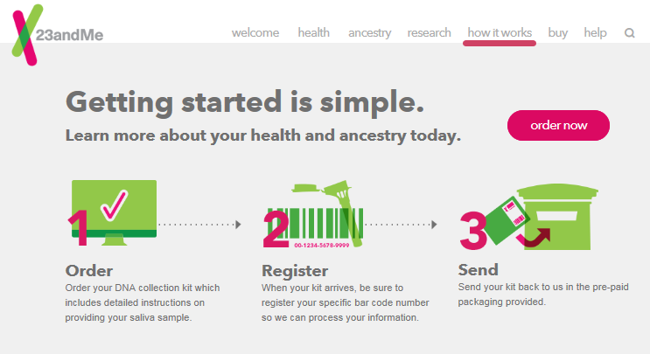
Starter: 23&me
https://www.23andme.com/en-gb/
Notes:
How does the process actually work?
1 - You pay on-line and are sent a DNA testing kit (collection pot for spit, return envelope and barcode)
2 - You register your details alongside the barcode on-line
3 - You spit in the pot, post it back in the envelope supplied and sit back and wait for the results…

Slide 4
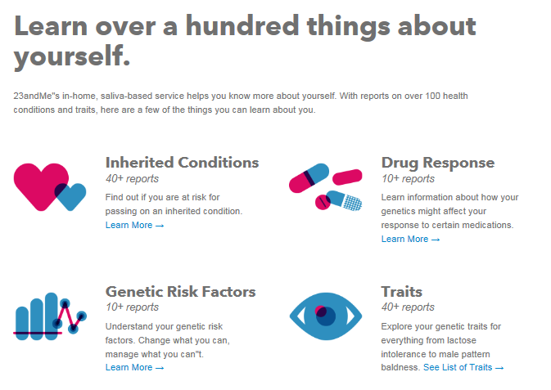
Starter: 23&me
https://www.23andme.com/en-gb/
Notes:
What happens to your DNA?
DNA sequencing is used to determine whether you have any variation (difference) in your DNA (genotype) at about 100 specific locations known to be linked to specific functions (phenotypes).
There are 4 sections into which your personal genome data is arranged:
Genetic risk factors
Inherited conditions
Traits
Drug response

Slide 5
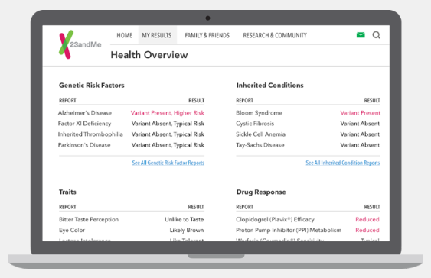
Starter: 23&me
https://www.23andme.com/en-gb/
Notes:
What do the results look like?
You receive a ‘Health Overview’ of your results arranged into these 4 sections:
Genetic risk factors
Inherited conditions
Traits
Drug response
For each DNA locus analysed (of which there are about 100) you receive information on whether you have any variants and research paper references for you to find out more.
You also receive information on your ancestry.

Slide 6
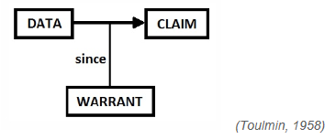
Argumentation
Argumentation involves students in discussion and thinking processes which Abrahams and Millar (2008) refer to as having ‘minds on’ the science.
http://www.nuffieldfoundation.org/practical-work-learning/ approach-1-argumentation
Notes:
Argumentation is a fancy word for scientific discussion of issues.
Claim: a conclusion or assertion. (A counter-claim is an opposing conclusion or assertion).
Data: the evidence and facts used to support the claim.
Warrants: statements (rules, principles, etc.) which explain the connections between the data and the claim/conclusion/assertion.
This model represents a relatively simple concept of an argument. By working within this model, students are encouraged to question whether a claim has any merit by considering the evidence, principles and assumptions on which the claim is based.
Here is an example which puts this model into practice.
Chelsea is a better football team than Arsenal [claim]. It has won more football matches at home and away [data] because its players have superior skills [warrant]. (Osborne, Erduran and Simon, 2004b)

Slide 7
Argumentation
Claim (assertion):
Data (evidence or facts in support):
Warrants (connecting the evidence and the assertion):
“23&me genome testing will make me better informed about my health”
“I would have information about my DNA”
“This would let me know if I was more likely to suffer from particular health problems and so I could change my lifestyle to help be healthier”
Notes:
Based on your reading, what would a counter-claim be?
Argumentation
Group / pair work: Students use information from their pre-reading to put together 2 claims for and 2 claims against personal genetic testing through companies such as 23&me.
We’ll return to this at the end of the session.
Suspense

Slide 8

Plenary: 23&me
Notes:
We started this session by saying that ‘Companies like 23&me are able to scan our individual genetic make-up. They offer direct to consumer genetic testing. Who wouldn’t want to understand the information contained in their DNA? But is this an appropriate way to try and understand it?’

Slide 9
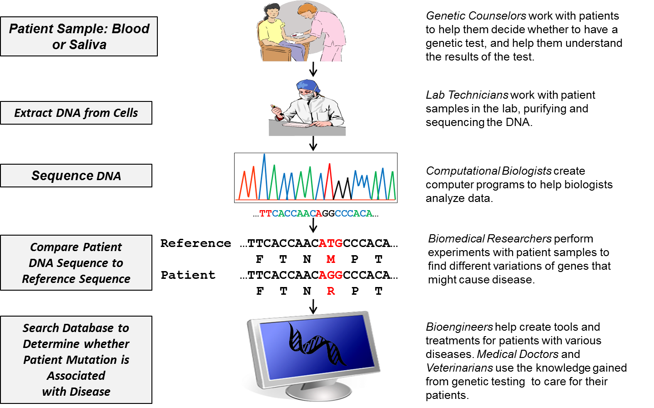
Plenary: 23&me
Notes:
You’ve had a chance to work through a particular scenario, experiencing:
the different jobs that contribute to the understanding of our genetic make up
the process of genetic testing and analysis, and
the difficulties that genetic testing can cause within family units.

Slide 10
Plenary: 23&me
Notes:
Now you need to revise your statements about genome testing. Are you still happy with them. Is there anything you would add in light of what we’ve done?
Discuss some of the claims and counter claims.

Slide 11
Plenary: 23&me
“Direct to consumer genetic testing is an appropriate way to understand the information contained in DNA.”
Agree
Disagree
http://www.nationalstemcentre.org.uk/elibrary/resource/2293/exploring-issues-a-teachers-guide
Notes:
Now it’s time to make up your mind. Using a line of agreement (in which one side of the classroom is designated as absolutely agree, one side of the classroom is designated as the absolutely disagree, the middle is undecided and there is a continuum between…) get students to give their opinions on the statement,
“direct to consumer genetic testing is an appropriate way to understand the information contained in DNA”.
(Citizen Science, a joint project between the Wellcome Trust and At Bristol, is a resource for teachers to help facilitate classroom discussion on controversial science issues – I’ve found it very useful. The idea of a line of agreement is taken from their project. The web address is given.)

