Slide 1
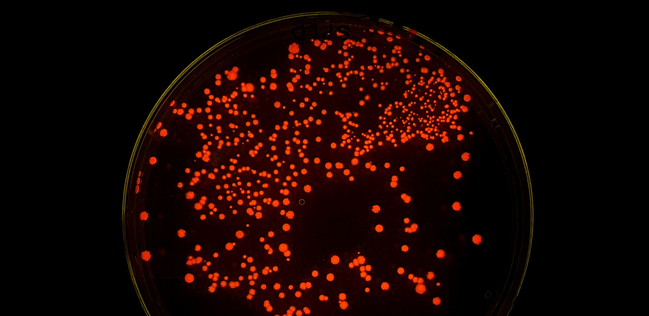
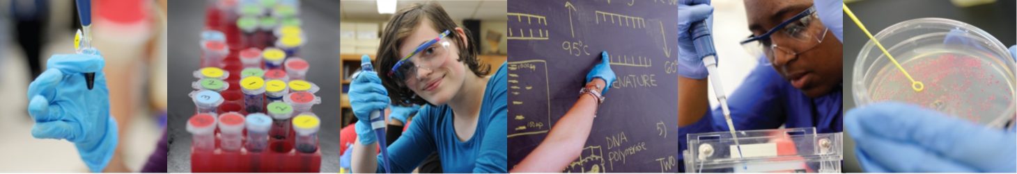

Amgen Biotech Experience
Community of Practice Network Meeting
October 2026

Slide 2




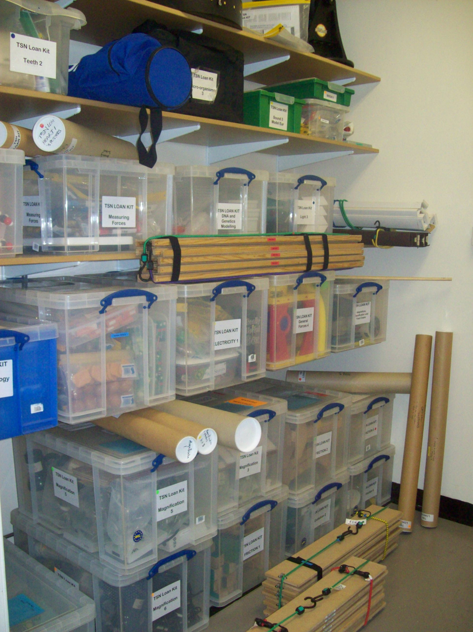


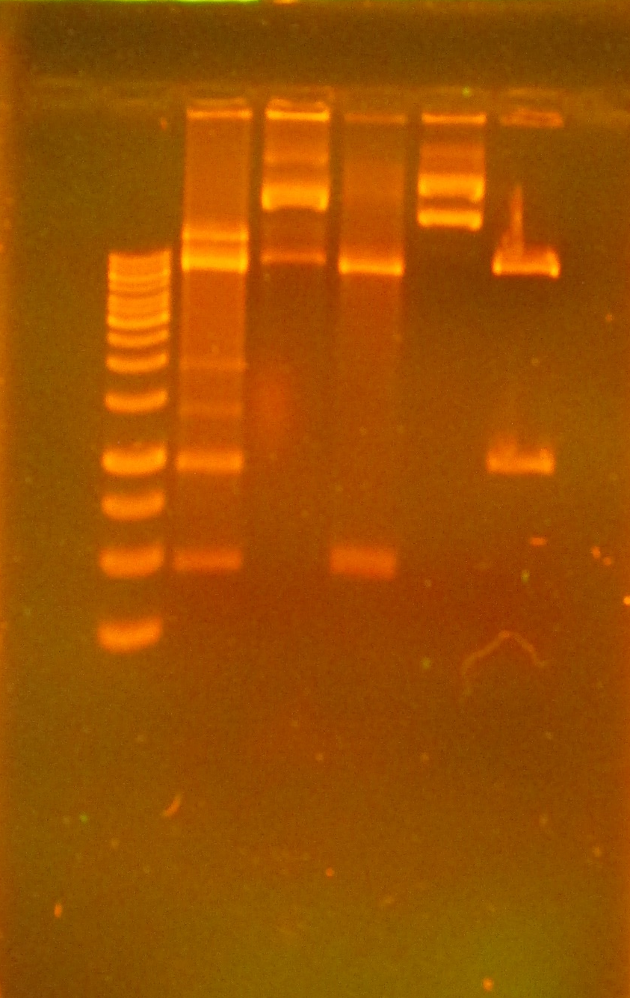



Slide 3

https://tsn.org.uk/abeuk/

Slide 4

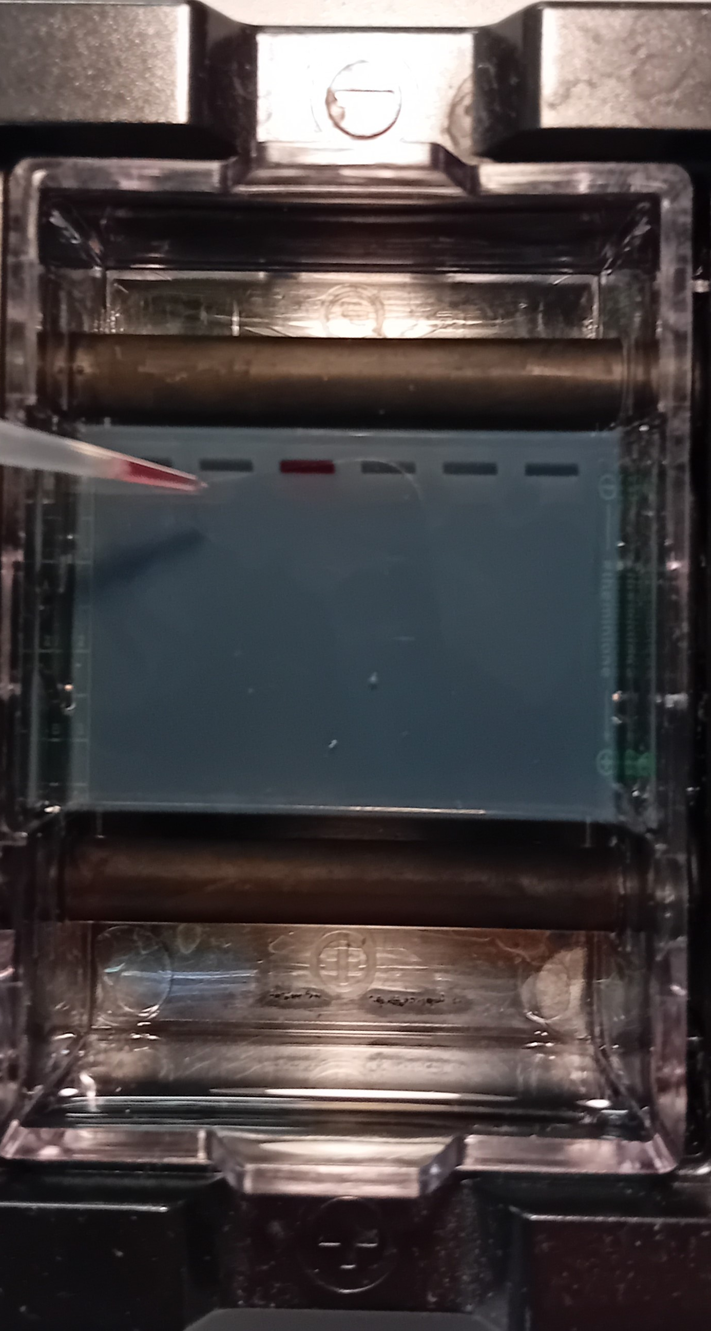
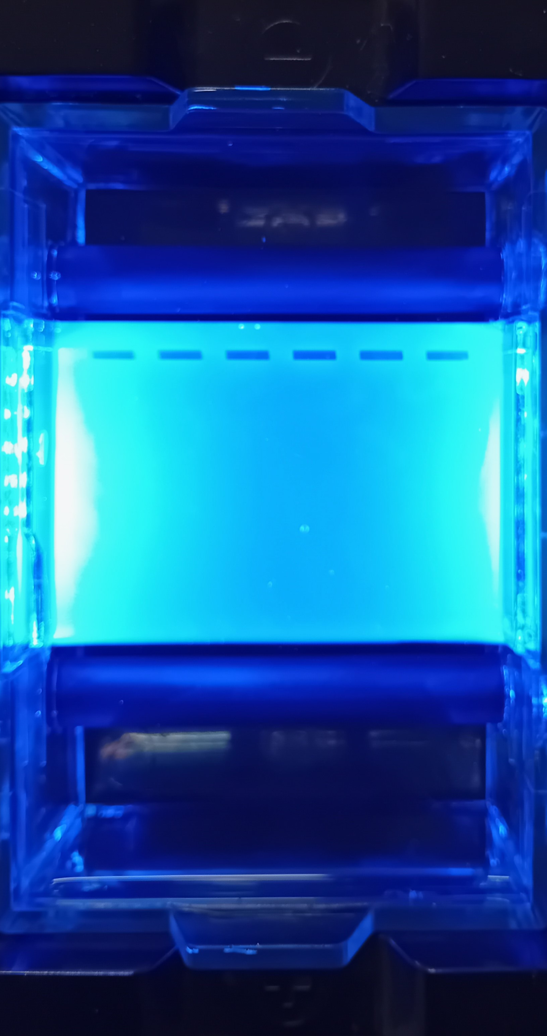
Spot the Difference?!
Make your MO even safer by loading without blue light

Slide 5
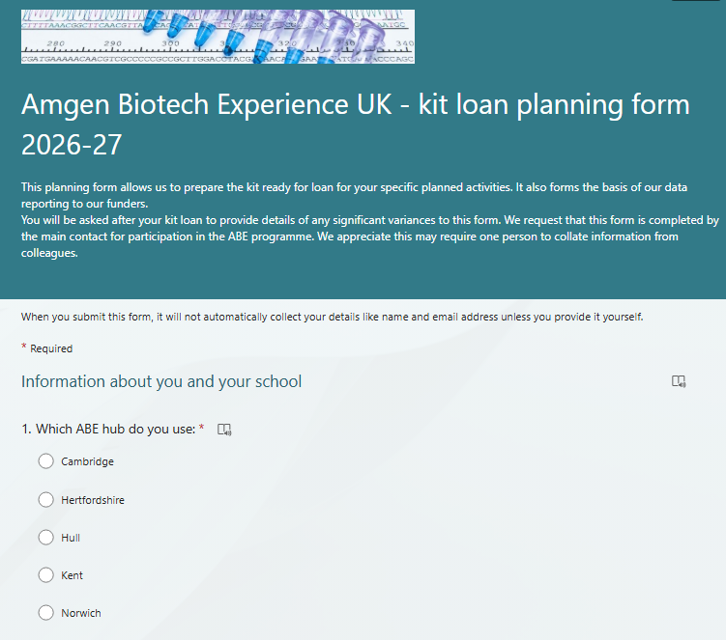
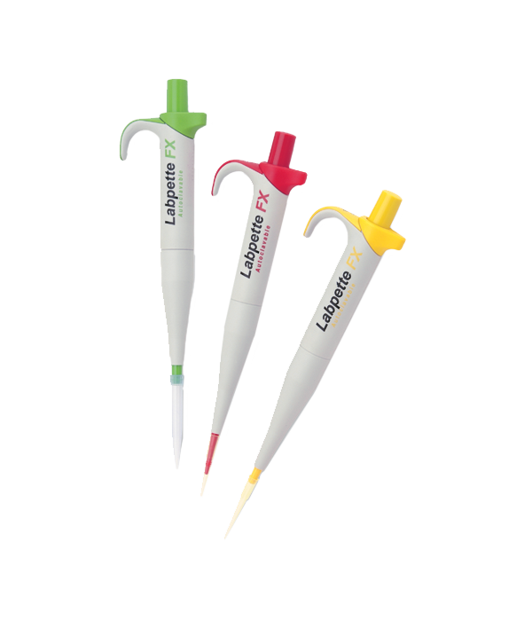
Data Collection is changing & becoming more important
How many educational pathways did you do ABE with? (Two KS3 National Curriculum classes and one A Level: Biology class, enter 2.)

Slide 6
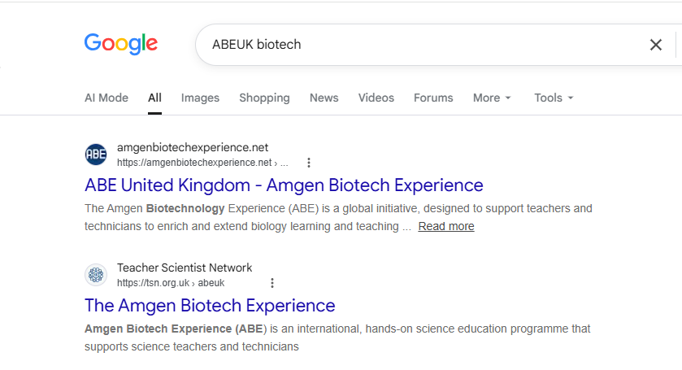
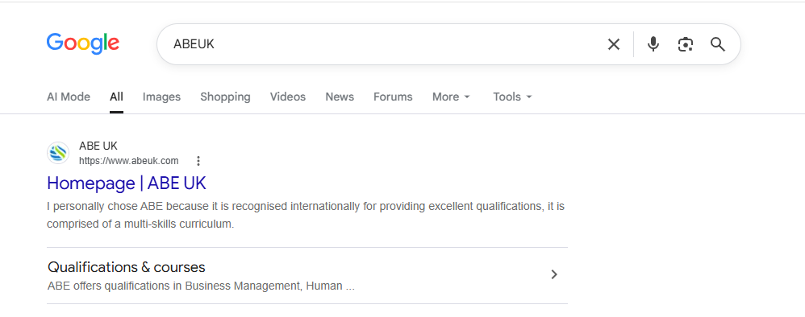
Bookmark (ribbon shape or a star)
🔖
⭐
📑
https://amgenbiotechexperience.net/uk/

Slide 7

https://amgenbiotechexperience.net/uk/
[ https://www.amgenbiotechexperience.com/ ]

Slide 8
One Stop Shop for all things ABE(UK)
Home
What is ABE
Programme
Resources
Our Hubs
FAQ
Contact

Slide 9
One Stop Shop for all things ABE(UK)
Home
What is ABE
Programme
Resources
Our Hubs
FAQ
Contact

Slide 10
One Stop Shop for all things ABE(UK)
Home
What is ABE
Programme
Resources
Our Hubs
FAQ
Contact
Kit Loan
CPD
Feedback

Slide 11

One Stop Shop for all things ABE(UK)
Home
What is ABE
Programme
Resources
Our Hubs
FAQ
Contact
Contact names & email
Postcode and special instructions

Slide 12
One Stop Shop for all things ABE(UK)
Home
What is ABE
Programme
Resources
Our Hubs
FAQ
Contact
By category
Searchable
Bookmark (ribbon shape or a star)
🔖
⭐
📑
https://amgenbiotechexperience.net/uk/

Slide 13

Teacher & technician guides
Student Guides
Course powerpoints
ALL PASSWORD PROTECTED

Slide 14
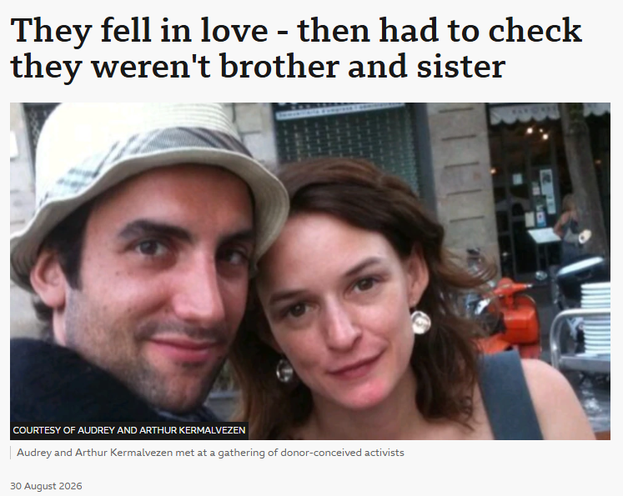
And finally …
In France, only a research scientist, doctor or judge can order and supervise a genetic test, and people can be fined more than €3,500 ($4,288; £3,191) for possessing a home testing kit.
Supporters of the law, in place since 1994, say it stops sensitive genetic data being given to commercial companies, and prevents family disputes being caused by unexpected results.
But Arthur points out that France is the only country in Europe that criminalises the use of such tests.
https://www.bbc.co.uk/news/articles/c8en3n29wdro

