Slide 1

Dr. Phil Smith, MBE
UK CPD lead for the #biotechexperience
@TSNphil
@ABEProgOffice

Slide 2
Why ABE Programme?
Contribute to ‘scientific literacy’
Encourage young people to pursue careers in biotech
Demonstrate the relevance of biotech to our everyday lives

Slide 3
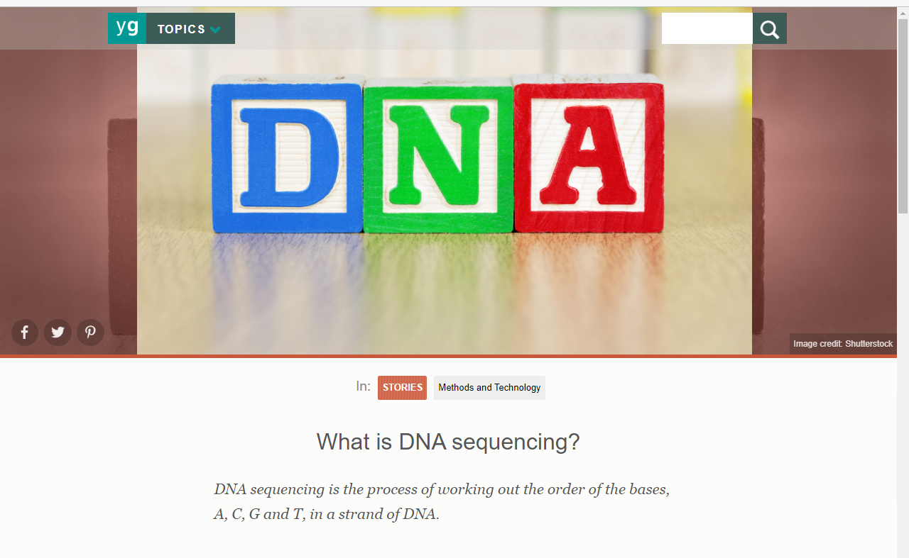
https://www.yourgenome.org/stories/what-is-dna-sequencing/
https://www.nature.com/scitable/topicpage/dna-sequencing-technologies-690/

Slide 4
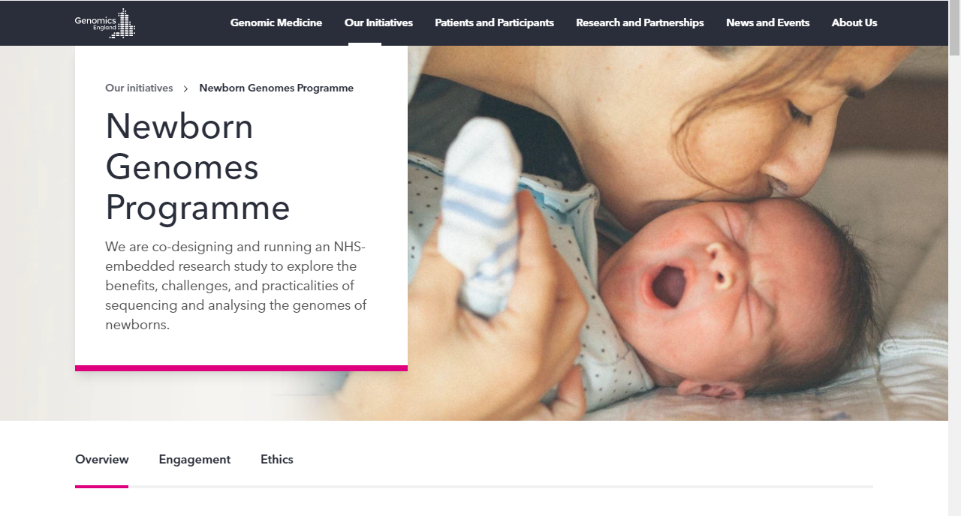
Whole Genome Sequencing at Birth – post natal care
Programme co-designed with families, the public and healthcare professionals
Embedded in the NHS – ensuring Equity of Access and a ‘Duty of Care’ to children and their families (infra-structure)

Slide 5
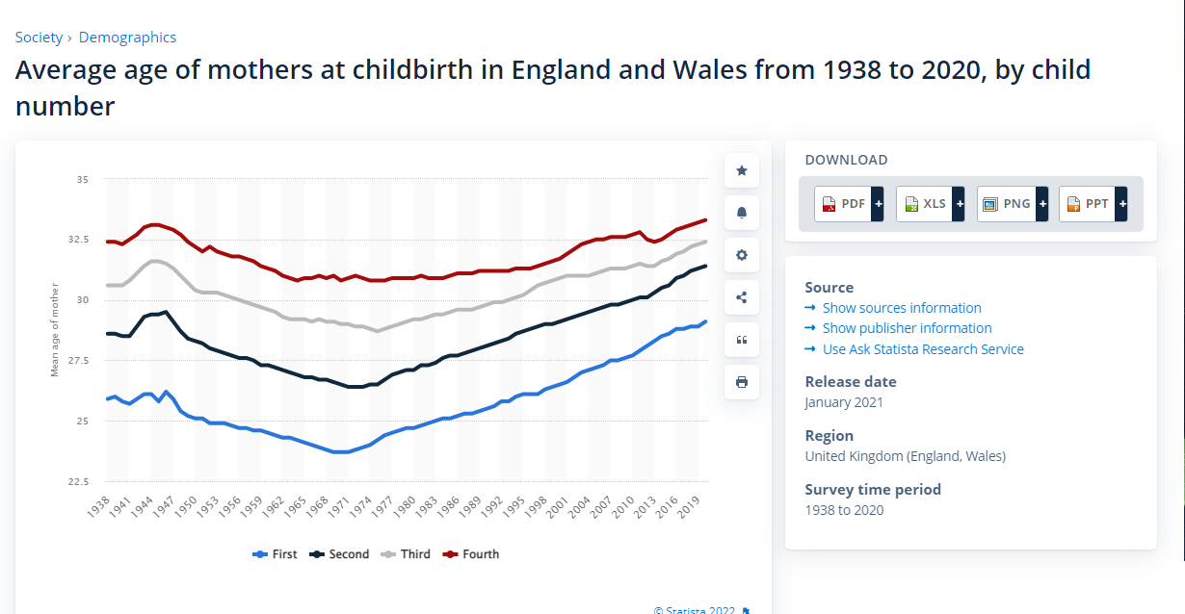
Thinking Numbers ….
10-15 years after leaving A-level, your young people are likely to be having their first child

Slide 6
Neonatal facts and figures
Approx. 100,000 babies/yr admitted to Neonatal Units in the UK
This means that around 1 in 7 babies born in the UK are admitted to a neonatal unit each year.
About 2000 babies die in their first month each year in the UK
‘Rare’ diseases and ‘Common’ diseases
Rare – approx. 7000diseases that we know of, >80% have a genetic component
Prevention need to get smarter, genome sequencing offers that potential
What do we do currently?

Slide 7
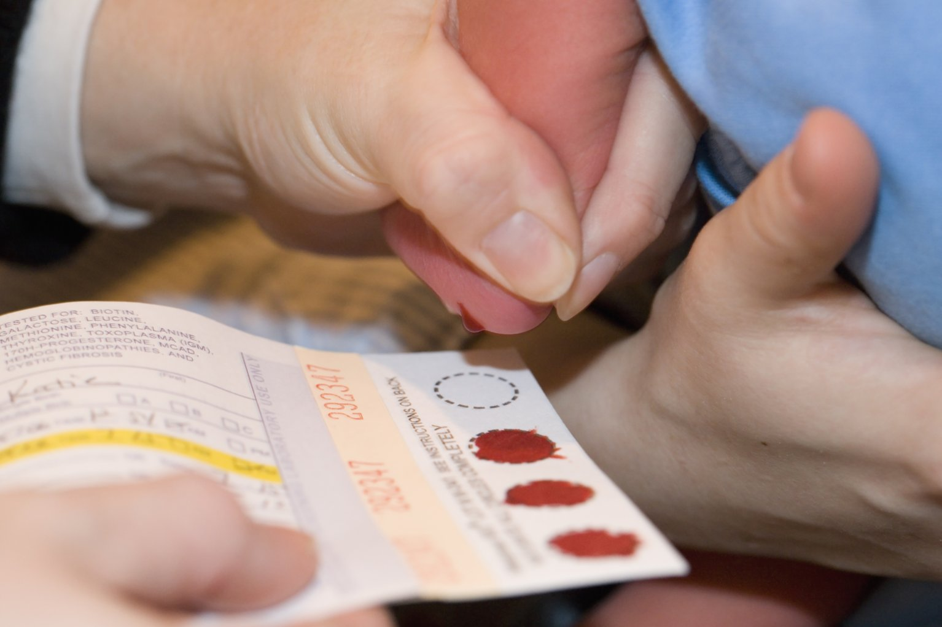
Heel-prick tests (blood spot cards)
Sickle Cell Disease
Cystic Fibrosis
Congenital hypothyroidism
Phenylketonuria
Maple Syrup Urine Disease
Isovaleric acidaemia
Glutaric aciduria Type 1
Homocystinuria
Medium-chain Acetyl-CoA dehydrogenase deficiency

Slide 8
Genomics in Medicine
What is here currently
What is fast coming?
Disease Management
Disease Care
Redirection of Care
Better reproductive choices
Better Genetic Counselling
Cascade Testing
What is Further in the Future
Personalised Medicine
Personalised Care Plan

Slide 9
Uncertainties
False positives
False negatives
Privacy and autonomy
Access to genomic data
Public benefit / ethics of commercialisation
When and to whom should we share results

Slide 10
Perspectives
Ethical perspectives – consent process, support for families, data governance, equitable & fair
Young people’s view is often very different to those of their parents
Commercial Companies – currently a shortage of licensed drugs available to treat children c/w adults
The General Public
Public has ‘red lines’ in terms of using health data
Cosmetic changes, surveillance, predictive insurance, targeted marketing
Capacity and needs of NHS, a trusted research environment
Most private, sensitive & potentially most valuable

Slide 11


Further Information
https://www.genomicsengland.co.uk/initiatives/newborns/ethics
https://www.nhs.uk/conditions/genetic-and-genomic-testing/

