Slide 1
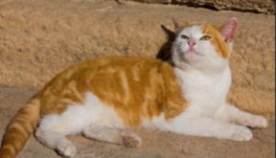
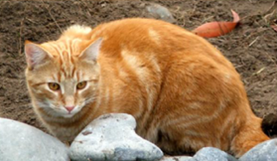
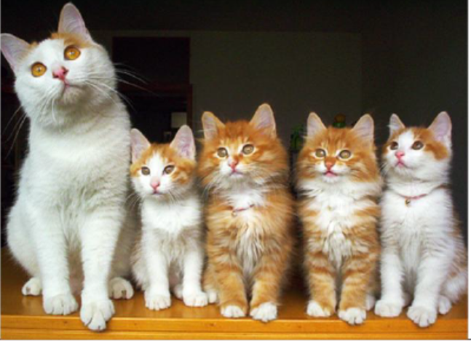
DNA FINGERPRINTING
Kitten Paternity Lab

Slide 2
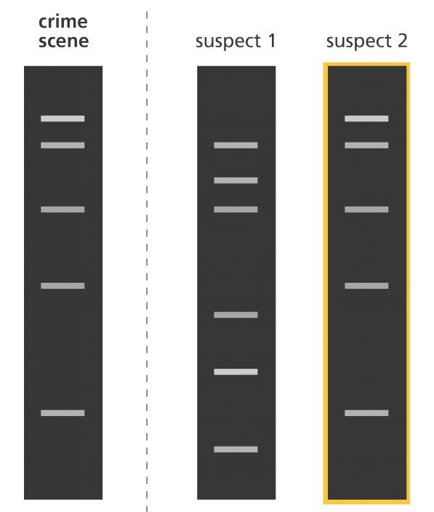
DNA FINGERPRINTING
DNA fingerprinting is a method of identifying individuals using their unique DNA patterns
Paternity (we’ll do this today!)
Criminal investigations
Paleontology/archeology
What else?

Slide 3
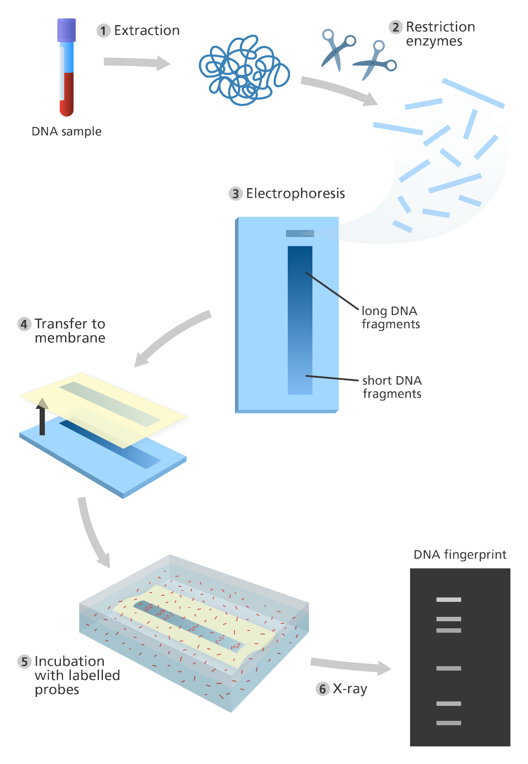
DNA Fingerprinting - RFLP
Restriction Fragment Length Polymorphism
Use restriction enzymes to generate unique patterns in an organism’s DNA
  “Fingerprint” or “Profile”
Can be used in paternity tests and crime scene DNA analysis

Slide 4
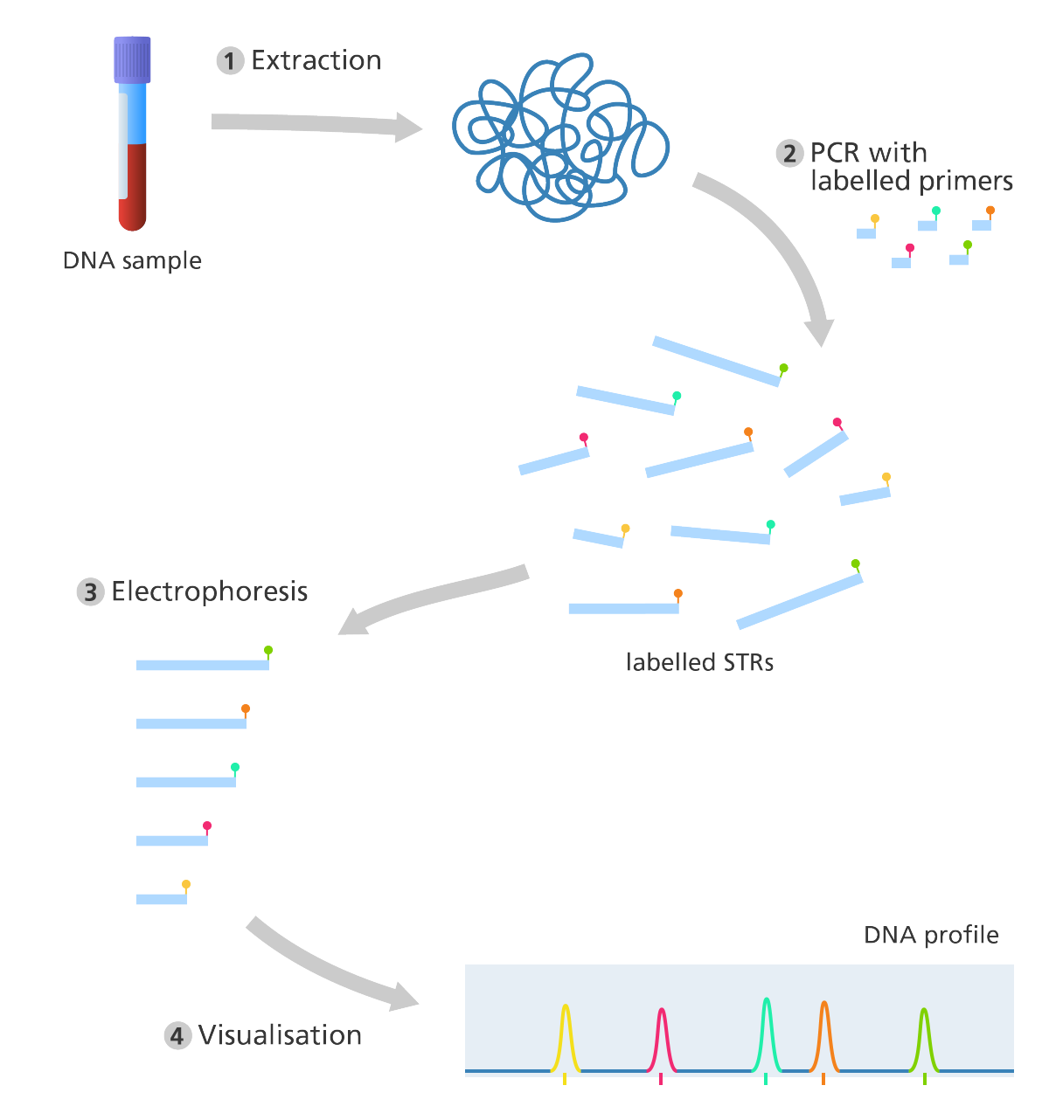
DNA Fingerprinting - PCR
Polymerase Chain Reaction
Uses primers targeted at unique Short Tandem Repeat (STR) sections of DNA to generate unique profile
Each section is amplified with labelled primers that can be visualized using gel electrophoresis

Slide 5
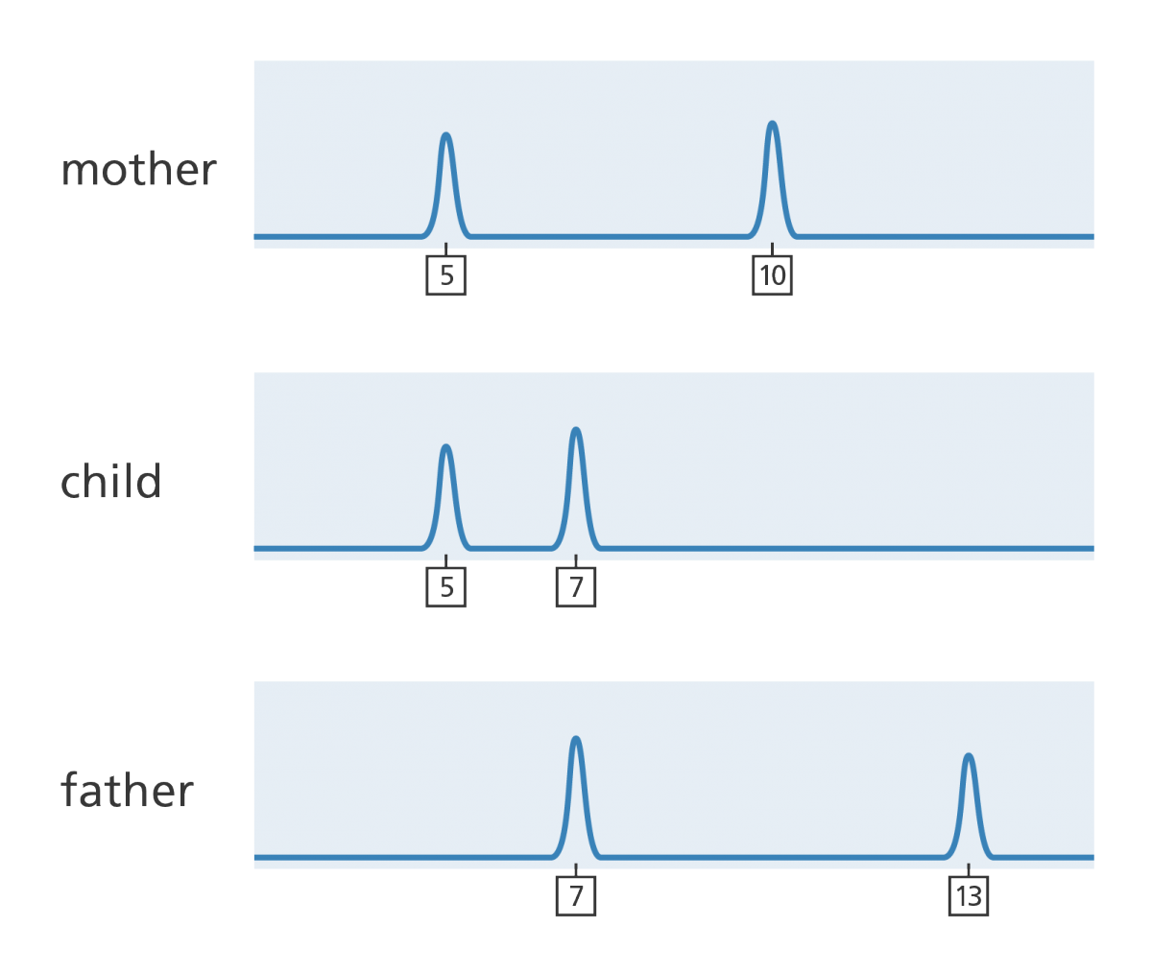
DNA Fingerprinting: RFLP vs PCR
RFLP
PCR

Slide 6
MEET HONEY
Mary’s cat, Honey, disappeared for two days about three months ago.
Honey came back without any injuries, still affectionate, and with an increased appetite.

Slide 7
FOUR MONTHS LATER….
Out pops 4 kittens!
From left to right:
Honey (Mom)
Molasses (Kitten #1)
Cream (Kitten #2)
Ginger (Kitten #3)
Sugar (Kitten #4)

Slide 8
MEET THE POTENTIAL DADS
Mary wants to know if the two neighboring cats could be the father: Tom or Butch.
Dad #1: Tom
Dad #2: Butch

Slide 9
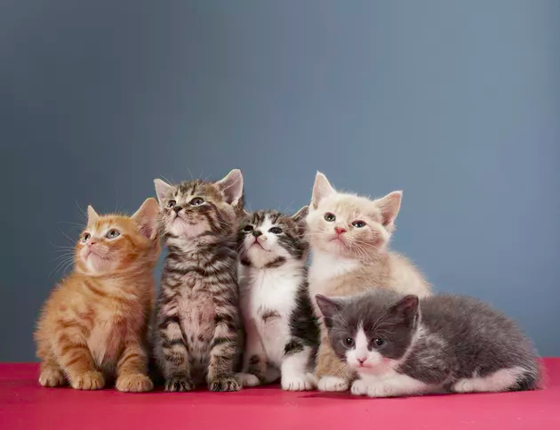
ONE LITTER, MULTIPLE FATHERS
It is known that the same litter of kittens can have multiple fathers – it may be possible that every single kitten in the litter has a different father!

Slide 10
COLLECTING SAMPLES
To analyze their DNA fingerprints, Mary has collected hair follicles from each adult cat and kitten, extracted DNA, and amplified their DNA using polymerase chain reaction (PCR).
It is now up to you to analyze these “DNA” samples using agarose gel electrophoresis and help Mary determine the genetic father of each of the kittens!

Slide 11
VISUAL MATCH
Looking at the photos, who might be the father of each kitten?
Honey
Molasses
Cream
Ginger
Sugar
Dad #1: Tom
Dad #2: Butch

Slide 12
TABLE 1: PHENOTYPE PREDICTIONS
KITTEN | POTENTIAL DAD TOM/BUTCH | EXPLANATION/RATIONALE
MOLASSES KITTEN #1
CREAM KITTEN #2
GINGER KITTEN #3
SUGAR KITTEN #4

Slide 13
LOADING GELS
Obtain the "DNA samples"
  there are seven microfuge tubes labeled P- V.
Centrifuge your sample tubes first. Make sure to balance the centrifuge!
Set your p20 pipette to 5µL and add a tip to the pipette
Load 5µL of sample P. If you want, you can skip the first well

Slide 14
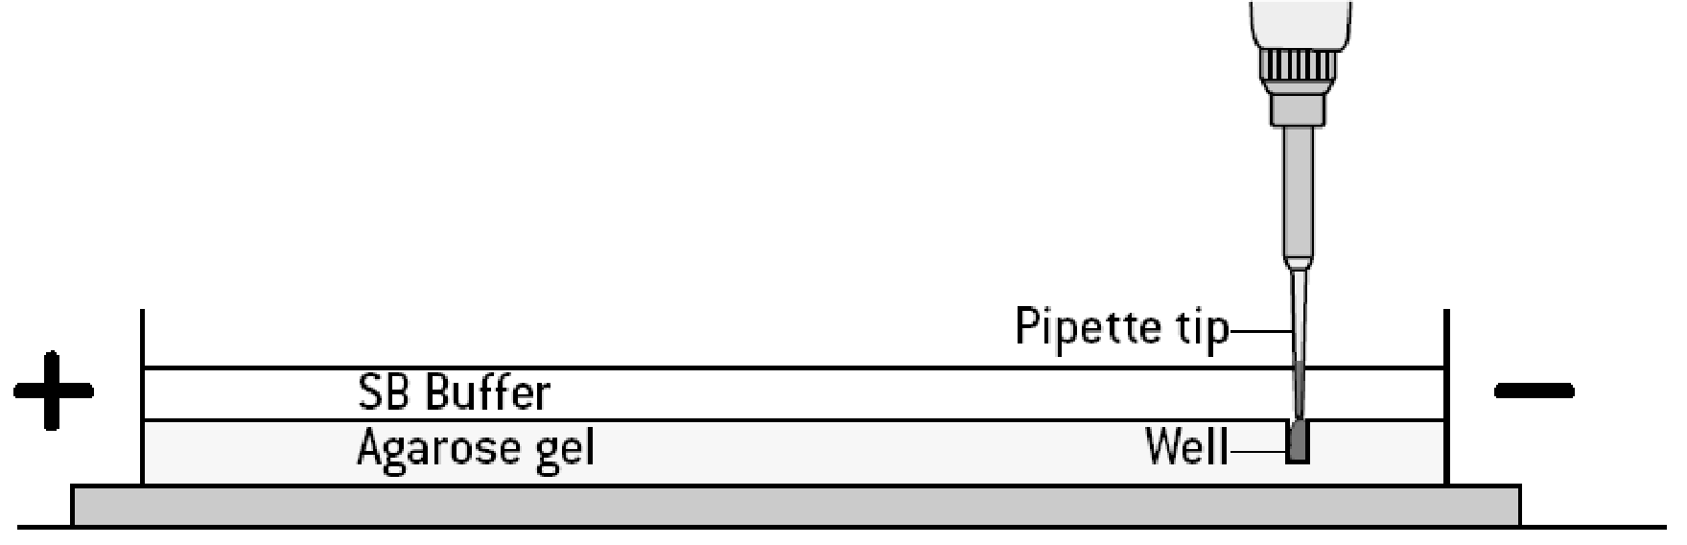
HOW TO LOAD A GEL
Insert pipette tip
Break the surface of the buffer but do not enter the well
HOLD at first stop while removing tip from buffer
Pushing to second stop may cause bubbles to form or expel your sample from the well

Slide 15
LOADING GELS II
Using new tips each time, continue to load 5µL of each sample in the order listed in Table 2.
Record the order that you have loaded your samples and any notes!

Slide 16
TABLE 2: GEL LOADING ORDER
Well | Tube | DNA Sample | NOTES (problems, loss of samples, etc)
1 | P | Tom (Dad #1)
2 | Q | Molasses (Kitten #1)
3 | R | Cream (Kitten #2)
4 | S | Honey (Mom)
5 | T | Ginger (Kitten #2)
6 | U | Sugar (Kitten #4)
7 | V | Butch (Dad #2)

Slide 17
GEL ELECTROPHORESIS SETUP
Tom
Kitten 1
Kitten 2
Honey
Kitten 3
Kitten 4
Butch
BLANK
BLANK
Run the gel for 15-20 minutes.@ 130Volts.
Check every 5 minutes starting at the 10-minute mark to preserve your results. This is to prevent loss of data if the gel should run too long.
Each “band” represents a unique piece of “DNA” amplified by differently colored PCR primer.

Slide 18
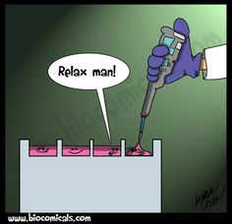
LET’S GET A-RUNNIN’!

Slide 19
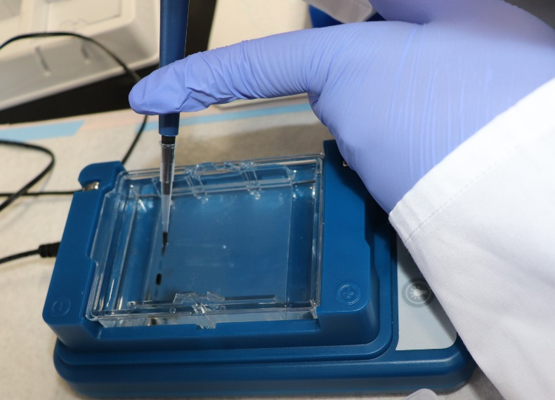
COMMON ISSUES
  Poor pipetting:
    Forget pipette tip
    Accidently expel all the sample from well
  Not enough practice handling a pipette- every student needs to practice

Slide 20
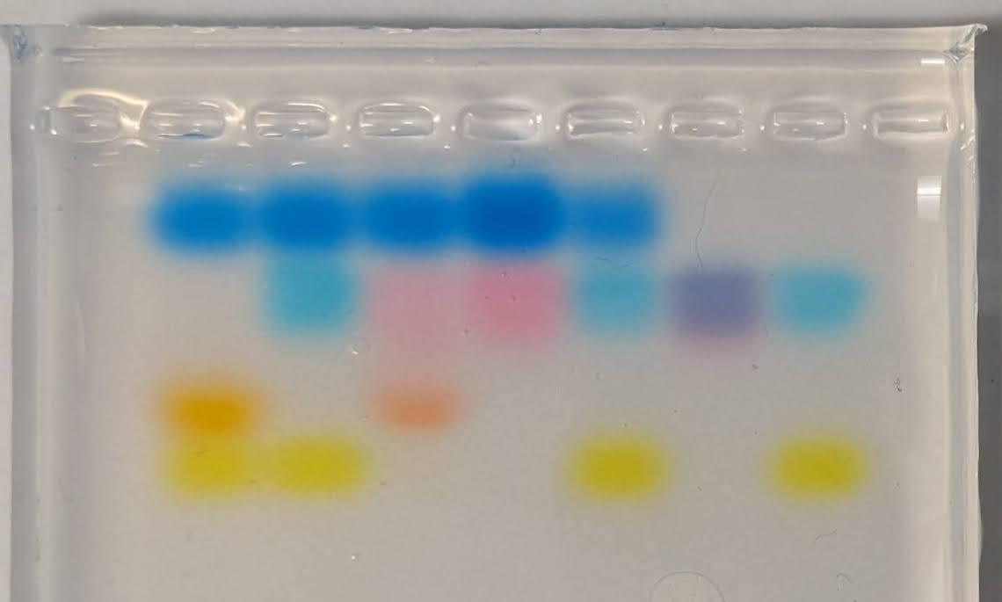
RESULTS: “DNA” GEL: Canada
P Q R S T U V
P: Tom, Dad #1
Q: Cream, Kitten #1
R: Molasses, Kitten #2
S: Honey: Mom
T: Ginger, Kitten #3
U: Sugar, Kitten #4
V: Butch, Dad #2

Slide 21
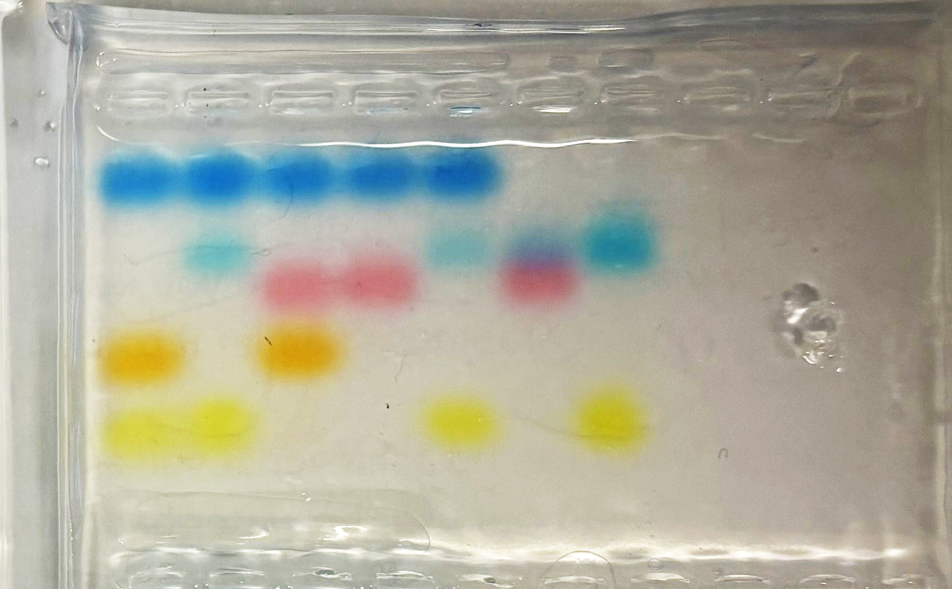
RESULTS: “DNA” GEL: RI
P Q R S T U V
P: Tom, Dad #1
Q: Cream, Kitten #1
R: Molasses, Kitten #2
S: Honey: Mom
T: Ginger, Kitten #3
U: Sugar, Kitten #4
V: Butch, Dad #2

Slide 22
TABLE 3: RESULTS ANALYSIS I
Tube | P | Q | R | S | T | U | V
Color Band | Tom Dad #1 | Cream Kitten 1 | Molasses Kitten 2 | Honey Mom | Ginger Kitten 3 | Sugar Kitten 4 | Butch Dad #2
Blue
Blue Pink
Orange
Yellow

Slide 23
TABLE 3: RESULTS ANALYSIS II
Tube | P | Q | R | S | T | U | V
Color Band | Tom Dad #1 | Cream Kitten 1 | Molasses Kitten 2 | Honey Mom | Ginger Kitten 3 | Sugar Kitten 4 | Butch Dad #2
Blue | Blue | Blue | Blue | Blue
Blue Pink |  | Blue | Pink | Pink | Blue | Blue Pink | Blue
Orange | Orange |  | Orange
Yellow | Yellow | Yellow |  |  | Yellow |  | Yellow

Slide 24
TABLE 3: RESULTS ANALYSIS III
Tube | P | Q | R | S | T | U | V
Color Band | Tom Dad #1 | Cream Kitten 1 | Molasses Kitten 2 | Honey Mom | Ginger Kitten 3 | Sugar Kitten 4 | Butch Dad #2
Blue | Blue | Blue | Blue | Blue
Blue Pink |  | Blue | Pink | Pink | Blue | Blue Pink | Blue
Orange | Orange |  | Orange
Yellow | Yellow | Yellow |  |  | Yellow |  | Yellow

Slide 25
TABLE 3: RESULTS ANALYSIS IV
Tube | P | Q | R | S | T | U | V
Color Band | Tom Dad #1 | Cream Kitten 1 | Molasses Kitten 2 | Honey Mom | Ginger Kitten 3 | Sugar Kitten 4 | Butch Dad #2
Blue | Blue | Blue | Blue | Blue
Blue Pink |  | Blue | Pink | Pink | Blue | Blue Pink | Blue
Orange | Orange |  | Orange
Yellow | Yellow | Yellow |  |  | Yellow |  | Yellow
Father | ---------- | Butch |  | ---------- |  |  | ----------

Slide 26
TABLE 3: RESULTS ANALYSIS VI
Tube | P | Q | R | S | T | U | V
Color Band | Tom Dad #1 | Cream Kitten 1 | Molasses Kitten 2 | Honey Mom | Ginger Kitten 3 | Sugar Kitten 4 | Butch Dad #2
Blue | Blue | Blue | Blue | Blue
Blue Pink |  | Blue | Pink | Pink | Blue | Blue Pink | Blue
Orange | Orange |  | Orange
Yellow | Yellow | Yellow |  |  | Yellow |  | Yellow
Father | ---------- | Butch | Tom | ---------- |  |  | ----------

Slide 27
TABLE 3: RESULTS ANALYSIS VII
Tube | P | Q | R | S | T | U | V
Color Band | Tom Dad #1 | Cream Kitten 1 | Molasses Kitten 2 | Honey Mom | Ginger Kitten 3 | Sugar Kitten 4 | Butch Dad #2
Blue | Blue | Blue | Blue | Blue
Blue Pink |  | Blue | Pink | Pink | Blue | Blue Pink | Blue
Orange | Orange |  | Orange
Yellow | Yellow | Yellow |  |  | Yellow |  | Yellow
Father | ---------- | Butch | Tom | ---------- | Butch |  | ----------

Slide 28
TABLE 3: RESULTS ANALYSIS VIII
Tube | P | Q | R | S | T | U | V
Color Band | Tom Dad #1 | Cream Kitten 1 | Molasses Kitten 2 | Honey Mom | Ginger Kitten 3 | Sugar Kitten 4 | Butch Dad #2
Blue | Blue | Blue | Blue | Blue
Blue Pink |  | Blue | Pink | Pink | Blue | Blue Pink | Blue
Orange | Orange |  | Orange
Yellow | Yellow | Yellow |  |  | Yellow |  | Yellow
Father | ---------- | Butch | Tom | ---------- | Butch | Butch | ----------

Slide 29
PHENOTYPE VS GENOTYPE
Honey
Molasses
Cream
Ginger
Sugar
Dad #1: Tom
Dad #2: Butch

Slide 30
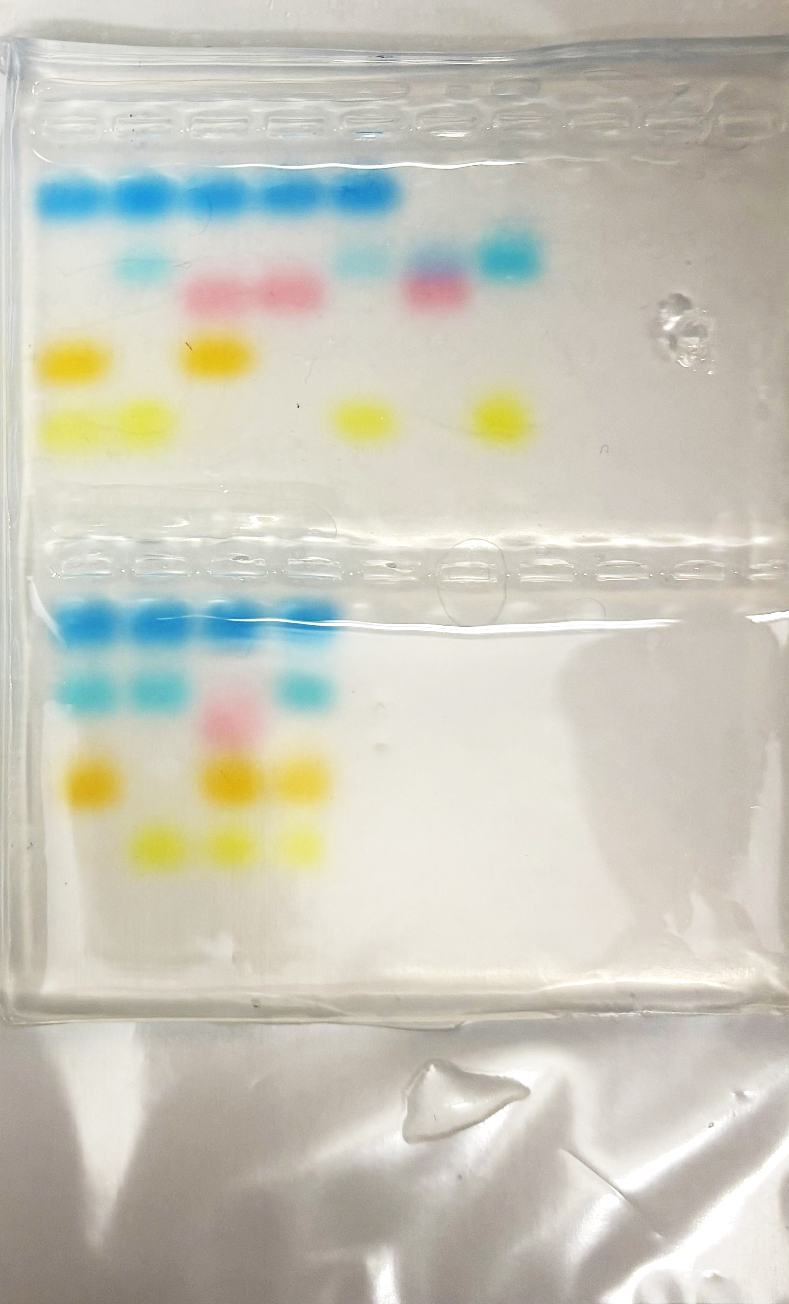
DO YOU SEE ANY OTHER PATTERNS?
P: Tom, Dad #1
Q: Cream, Kitten #1
R: Molasses, Kitten #2
S: Honey: Mom
T: Ginger, Kitten #3
U: Sugar, Kitten #4
V: Butch, Dad #2
P Q R S T U V

Slide 31
DO YOU SEE ANY OTHER PATTERNS? Twins
P Q R S T U V
Q: Cream, Kitten #1
T: Ginger, Kitten #3
TWINS??

Slide 32
DO YOU SEE ANY OTHER PATTERNS? Male
P Q R S T U V
P: Tom, Dad #1
Q: Cream, Kitten #1
T: Ginger, Kitten #3
V: Butch, Dad #2
MALE?

Slide 33
DO YOU SEE ANY OTHER PATTERNS? Female
P Q R S T U V
R: Molasses, Kitten #2
S: Honey (Mom)
U: Sugar, Kitten #4
FEMALE?

Slide 34
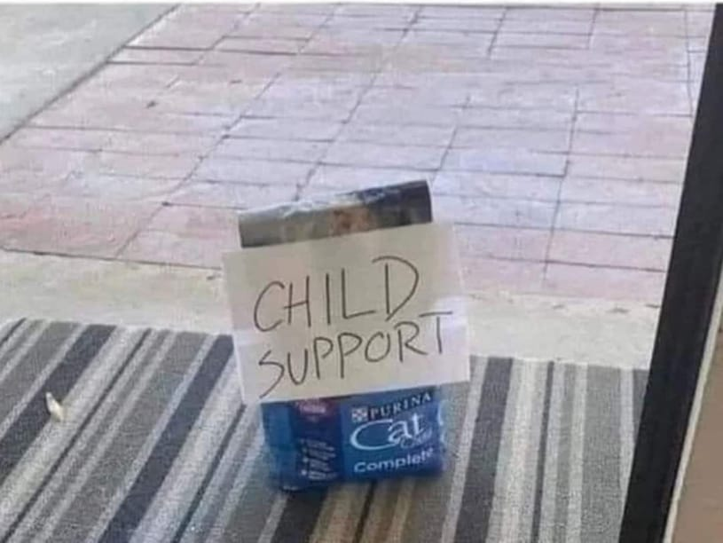
Cartoon

