Slide 1
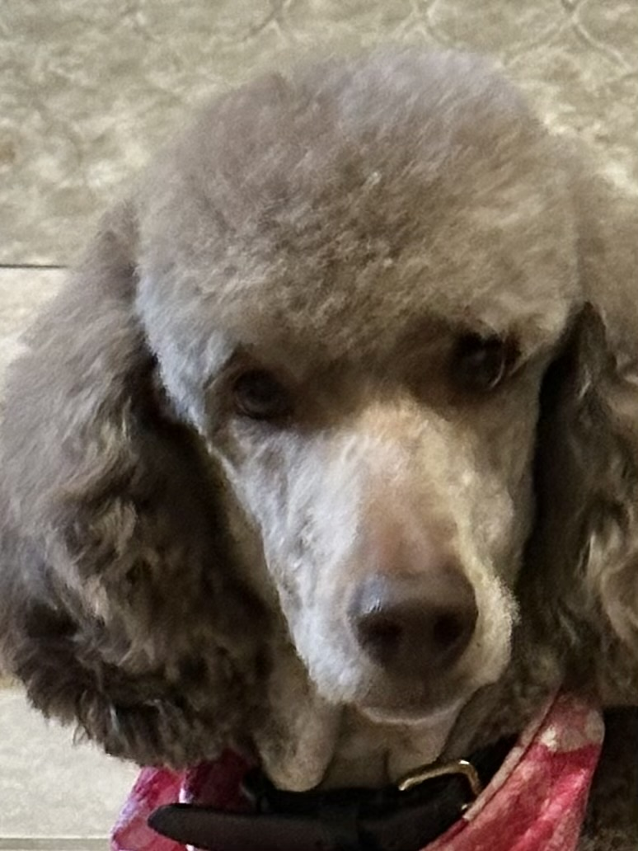
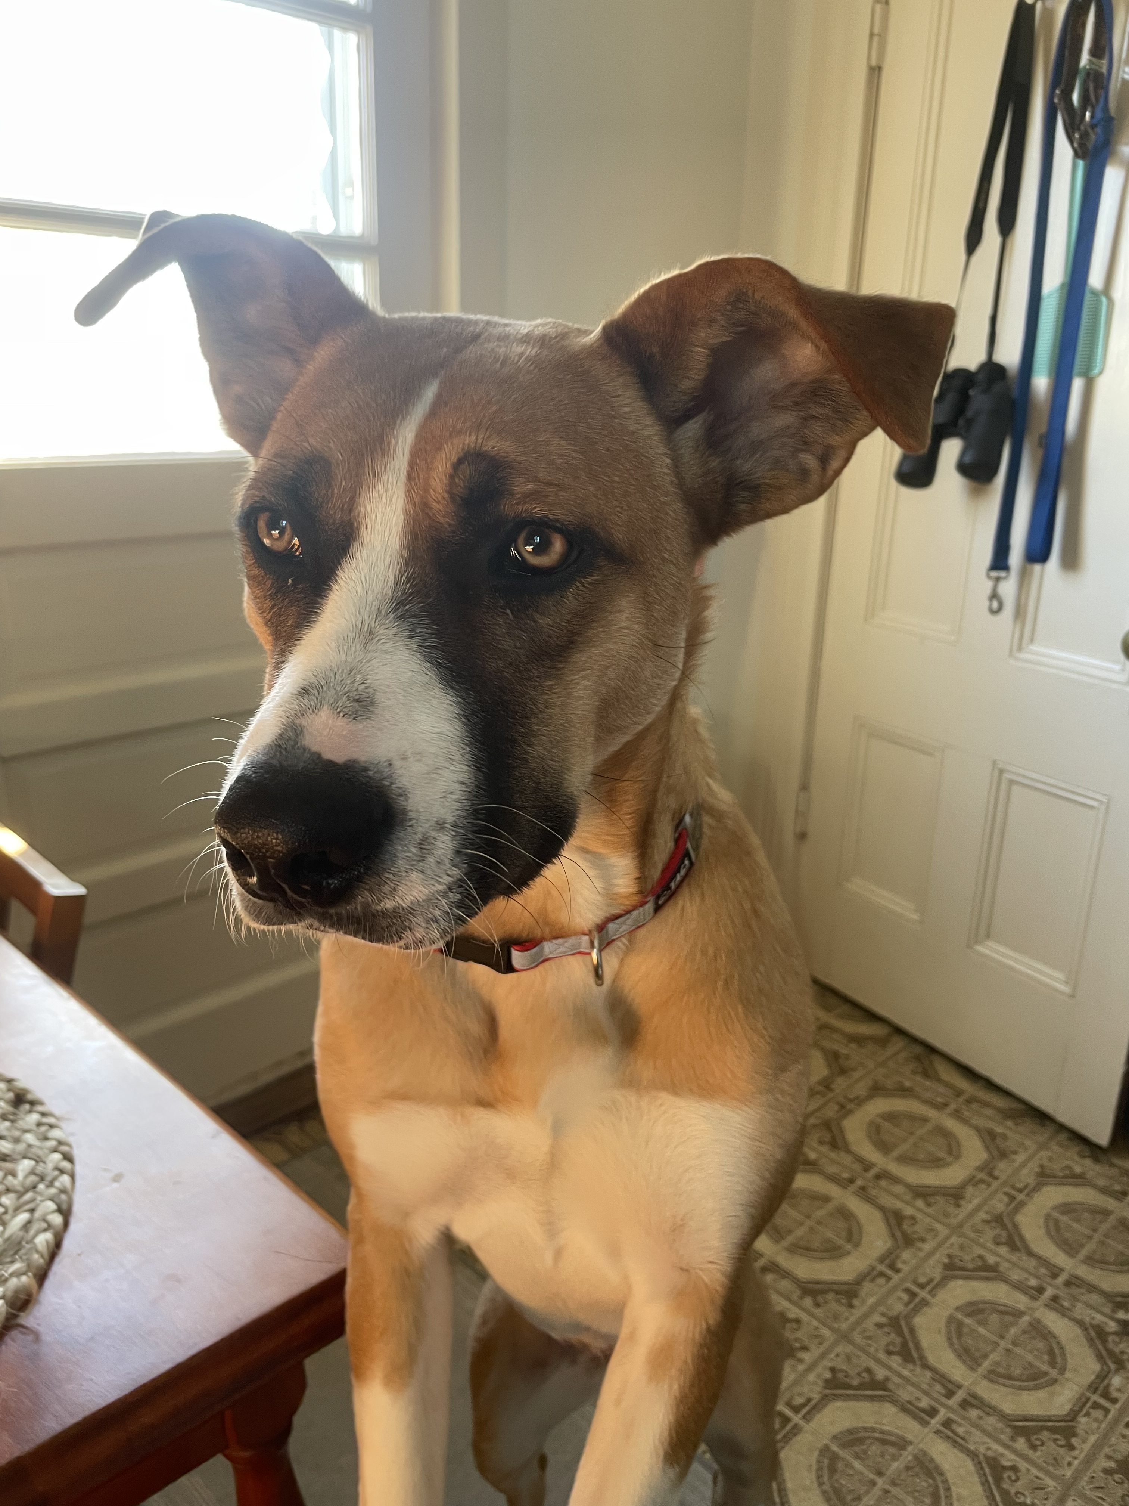
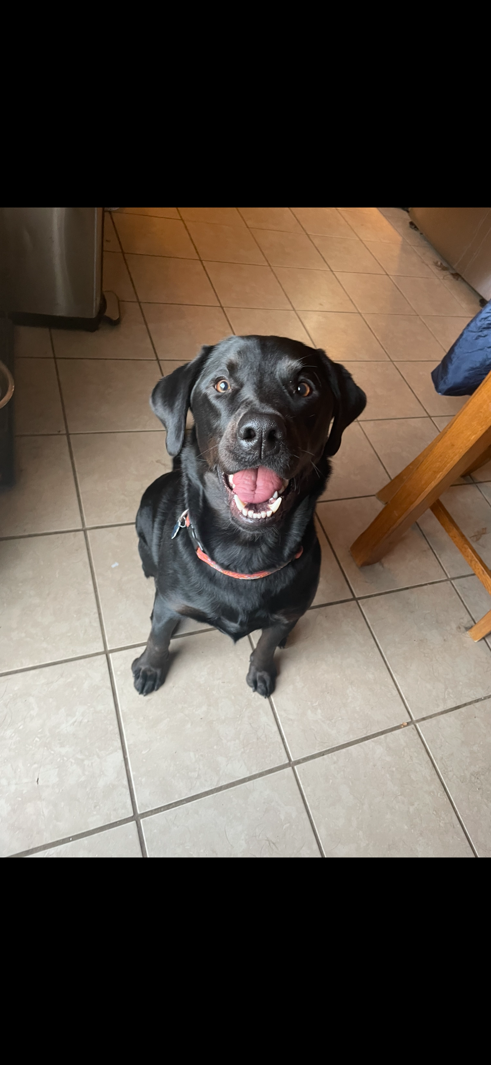
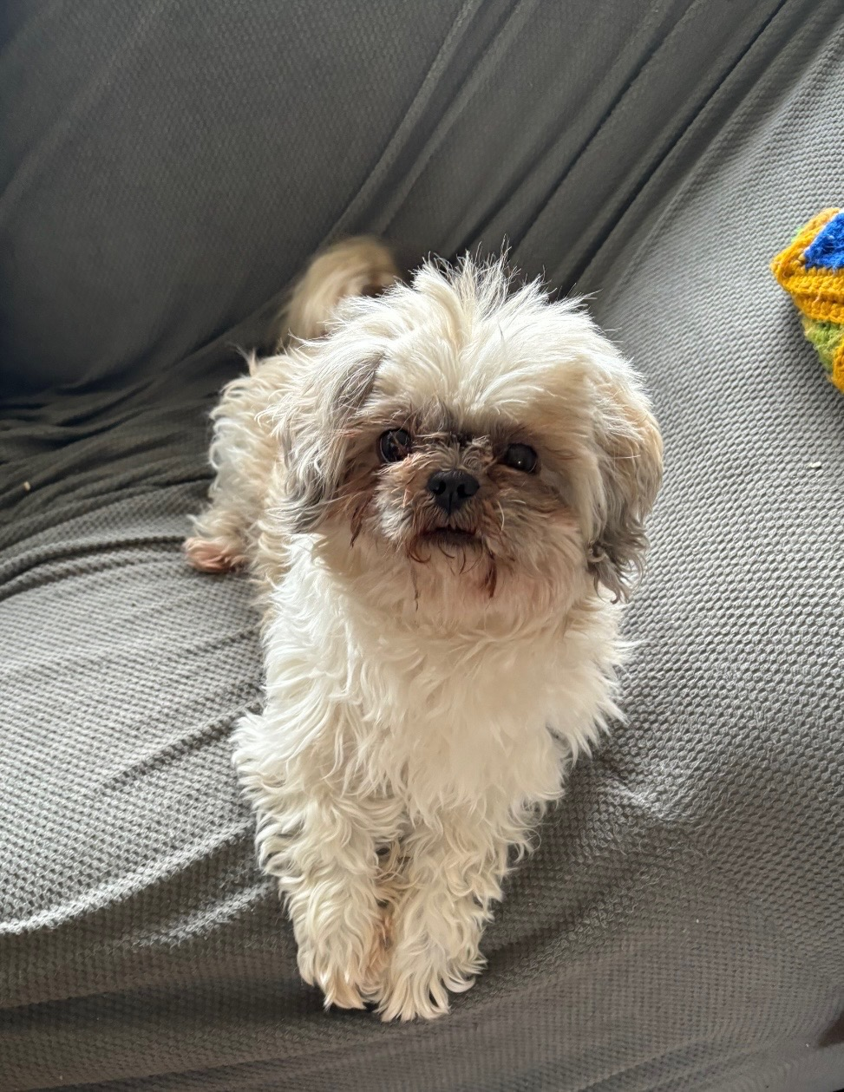
CSI Case:
Which Dog Ate
Jane’s Homework?

Slide 2
SCENARIO
Jane had been diligently studying and doing her biology homework all day, before going to a party Saturday night. When she came back home, her homework was half chewed up. There was still a big puddle of drool on her desk. Jane knew it had to have been one of the dogs that did this dirty deed -- but which one?
Her family has 2 dogs (suspects A and B). After questioning her brother, she also found out that the neighbors' two dogs (suspects C and D) had come over that night.

Slide 3
CRIME SCENE : SUSPECTS
C
Bear
A
Coco
B
Maisie
D
Zoey

Slide 4
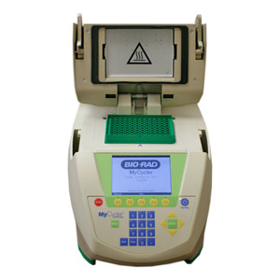
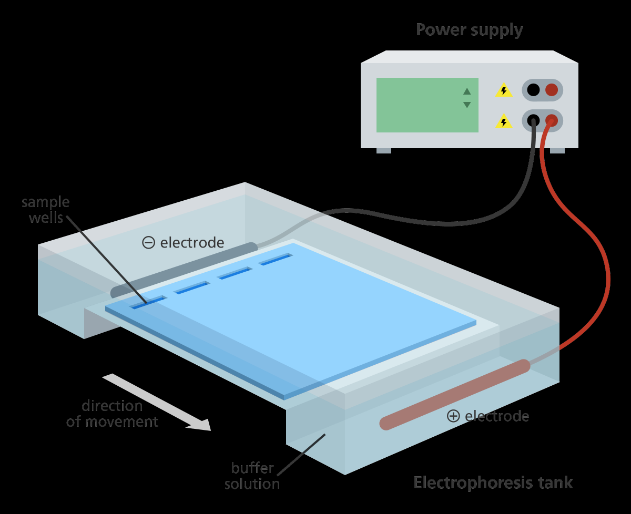
EVIDENCE
Jane took cheek swabs from her dogs and the neighbors' dogs to do a DNA fingerprinting analysis.
Jane amplified the carefully labeled DNA samples using PCR to amplify a unique repetitive sequences in DNA samples known as short tandem repeats(STR’s). These are highly variable, repeating sequences in the human genome
She then used restriction enzymes to cut the samples into fragments which she intends to run on gel electrophoresis to identify which dog ate her homework.
You, as her friend, offered to run the gel electrophoresis for her.
5'--GGATCC--3'
3'--CCTAGG--5'

Slide 5
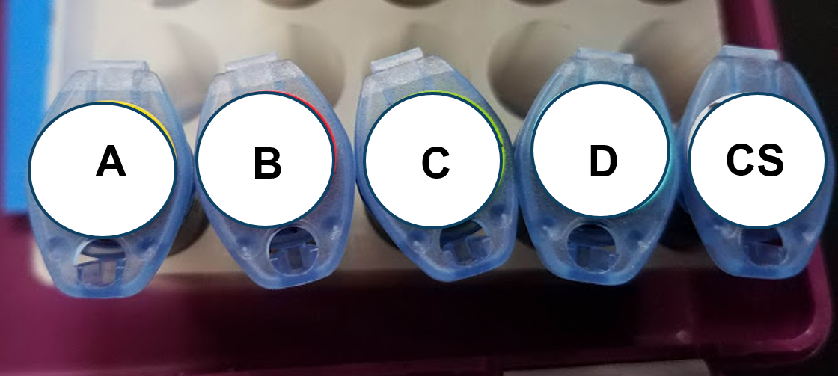
THE SAMPLES
CS: Crime Scene or Homework Evidence
A: Coco
B: Maise
C. Bear
D. Zoey

Slide 6
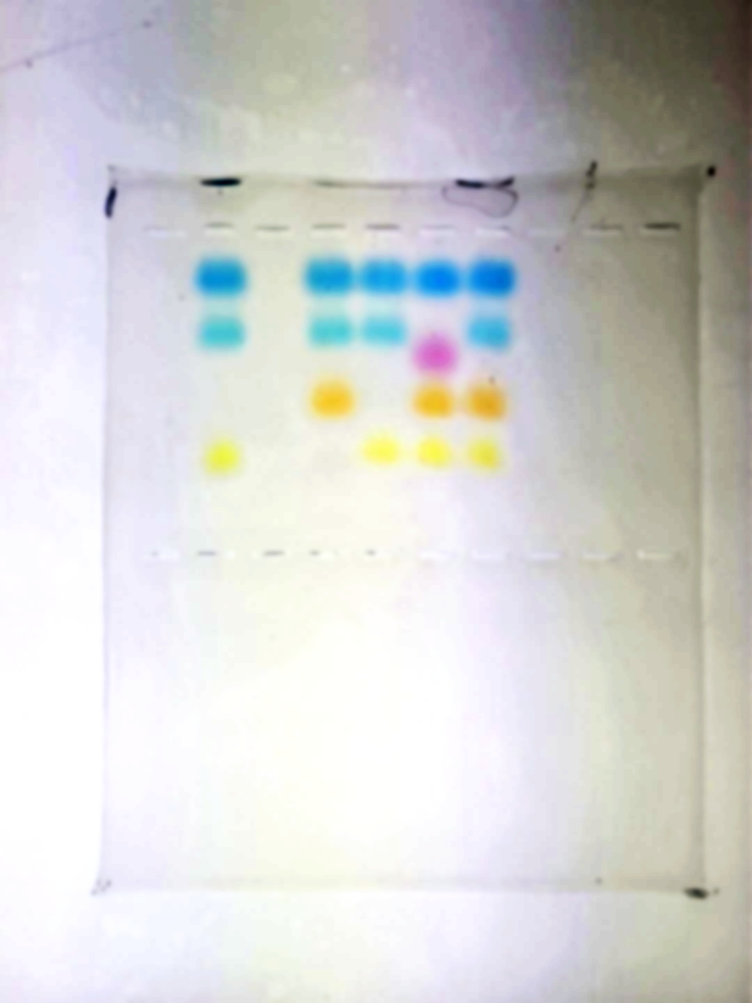
THE DATA
CS A B C D
CS: Crime Scene or Homework Evidence
A: Coco
B: Maisie
C. Bear
D. Zoey
Notes:
Molly ate the homework.

Slide 7
THE DATA ( Answer Key)
CS A B C D
CS: Crime Scene or Homework Evidence
A: Coco
B: Maise
C. Bear
D. Zoey
Notes:
Molly ate the homework.

Slide 8

SO WHAT HAPPENED?

Slide 9

WHAT IS YOUR CONCLUSION?
Be sure that you can cite
evidence to support your conclusion!

