Slide 1
WHAT’S DIFFERENT AND THE SAME THIS ACADEMIC YEAR?
ABE RI
Doreen Osgood, MS, Ph.D. , PI And Director

Slide 2
RI ABE SITE OFFICE
Doreen Osgood
Arielle Chaves
Kim Basa
Will Nebus

Slide 3
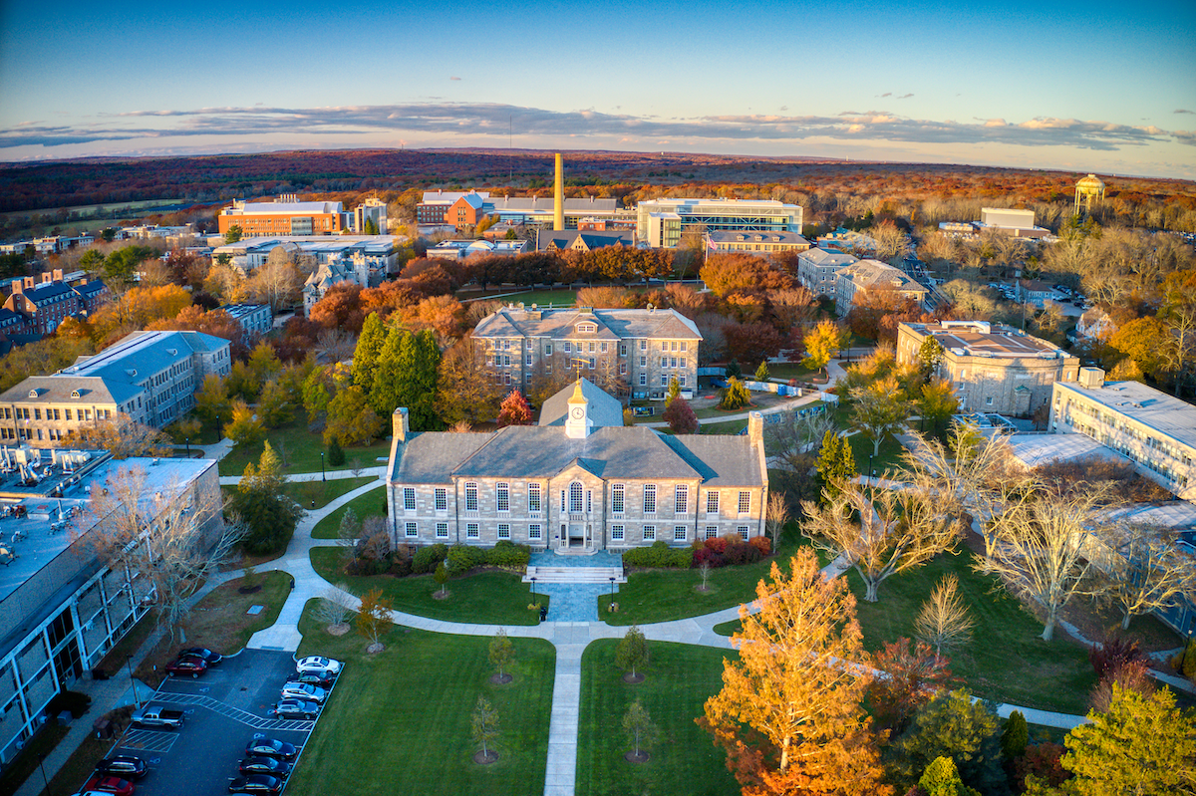
WE MOVED TO THE KINGSTON CAMPUS

Slide 4
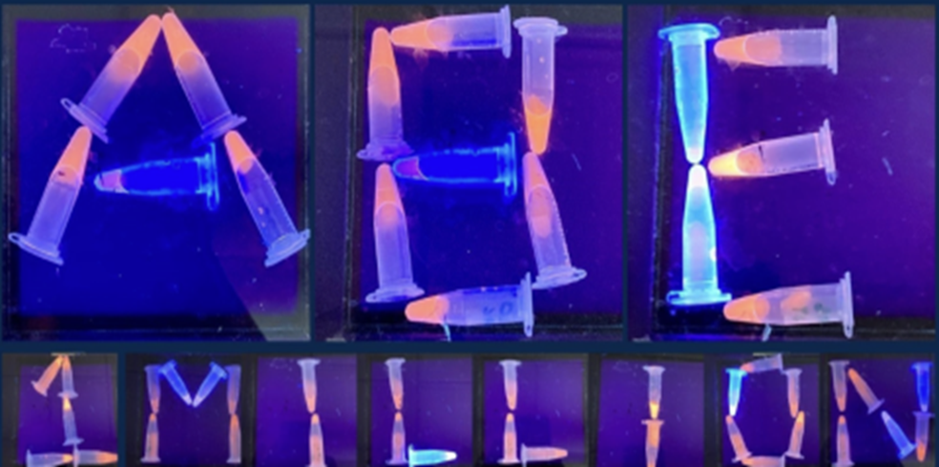
In 2024, the Amgen Biotech Experience (ABE) is celebrating reaching 1 million students
In 1990, leaders at Amgen set out to help teach high school students in their community about biotechnology. Using the latest tools and science, they created ABE.
Using the latest tools and science, they created ABE. For 34 years, more than 3,600 science educators have participated in ABE.

Slide 5
ABE RESOURCES
LabXchange
https://www.amgenbiotechexperience.com/
M3rlot!
ABE offers lab-based, classroom-based (non-lab), and web-based investigations in biotechnology, and provides professional learning opportunities and resources to support teachers and students in the use of ABE materials.

Slide 6
View the entire Foundations of Biotech package of materials (all of the below sequences are included):
Teacher Guide [7 MB] (password protected) | La Guía del profesor—todas secuencias (protección por contraseña)
Student Guide [6 MB] | La Guía del estudiante—todas secuencias
SEQUENCE OPTIONS
Abridged Genetic Engineering Sequence (16–18 class sessions)
The Abridged Genetic Engineering Sequence is identical to the Complete Genetic Engineering Sequence except that students are provided with the recombinant plasmid rather than creating it themselves.
Teacher Guide (password protected) M3rlot!
Student Guide
Related Resources
List of Laboratory Reagents
Abridged Genetic Engineering Pathway PowerPoint
List of Laboratory Reagents
Colony PCR (1–2 class sessions)
The Colony PCR lab is designed to be used as part of Foundations of Biotech. In this lab, students sample a colony from one of their plates and perform PCR on it to confirm the presence of the desired plasmid.
Teacher Guide (password protected) | Guía para el profesor (protección por contraseña)
Student Guide | Guía para el estudiante

Slide 7
ABE RI RESOURCES
ABE RI website https://amgenbiotechexperience.net/rhodeisland/node/511
Access directly or through the Amgen Biotech Experience Website (register)
ABE RI website
Resources for each lab: 1, 2a, 4a, 5 and 6 and Colony PCR
Quick guides for Gel making and resource binder information
Videos to be coming (we hope)

Slide 8
LAB GUIDES: CURRENT 2019
Manuals/Guides
All sequences available online for print
Website; curriculum; teacher/student guides
Teacher guide password protected:
M3rlot!
If using 2015; Begin at Tab C
ABR RI Resource Binder: one copy will be in your kit. Please return. PDF also available on the Amgen Biotech Experience RI website

Slide 9
PROGRAM EXPECTATIONS

Slide 10
POLICIES FOR ABE SCHOOL SITES – FROM P.O.
New teachers need to be trained at an ABE PDI before they can sign up to borrow ABE materials and equipment
Do not supply materials and equipment to labs where the teacher has not yet been trained
Annually, each teacher who participates in the ABE program should submit a signed copy of the Amgen Biotech Experience Expectations and Policies Form prior to or when picking up their ABE materials

Slide 11
PROGRAM EXPECTATIONS
Contact Coordinator (Arielle) to confirm date scheduling
Pick kit up and return on the dates agreed upon
Return kit as it was received
Notify Coordinator about any broken equipment
Any items not returned are reported to the EDC. School that do not return all items will not be able to borrow any future kits.

Slide 12
REQUIRED DOCUMENTS: DATES TO BE DETERMINED
Expectations and policies form: Each teacher!
Teacher information form : To be filled out by each teacher.
Kit request form: To be filled out by the Lead Teacher. Must list all teachers utilizing any portion of the kits.
Must list all participating teachers and contact information
New! After Rotation Survey

Slide 13
KIT SCHEDULING

Slide 14
KIT CONTENTS
How to unpack: Put refrigerator and freezer items away ASAP.
Equipment and supplied checklist: Check that you receive what is indicated on the list.
Resource Binder
How to store: Keep track of kit contents.
How to pack: Try to put items back in appropriate labeled bin
All plastic ware, dyes, equipment, columns and reagents must be returned. Even empty bottles!

Slide 15
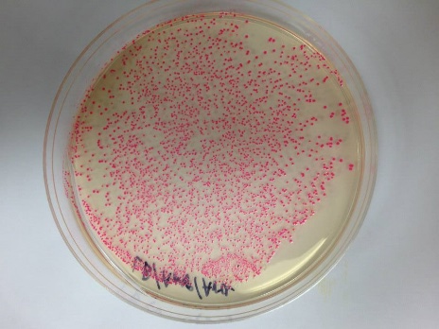
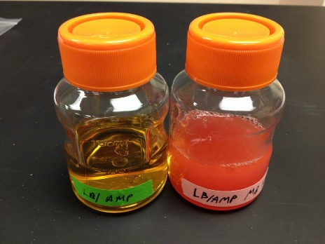
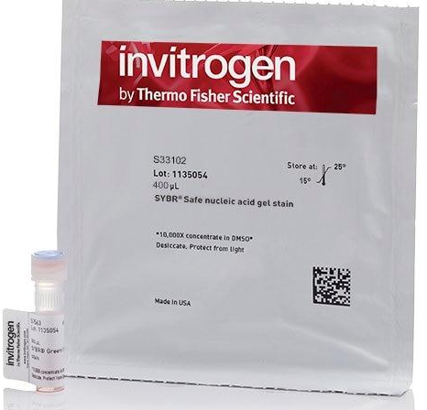
THE ADDITIONAL LABS CHANGES
4A: Post Stain: We will no longer provide a Bottle of 1xSB with Sybersafe
4A/Colony PCR: SyberSafe will be replaced with Gel Green. Same dilution. Still light sensitive
6A – Protein purification preparation. Only will give out “transomed cells’ if requested.
The Amgen Biotech Experience (ABE) offers lab-based, classroom-based (non-lab), and Web-based investigations in biotechnology.

Slide 16
THE ADDITIONAL LABS CHANGES
ABE’s classroom-based Exploring Precision Medicine mirrors the lab-based method but is designed for classroom use. PTC” bitter taste testing” PCR
check out our classroom-based version.
The module explores the connections between genes and traits. Students learn how slight genetic differences can impact how well a patient responds to certain medications.
Working with classmates and using online resources, students examine how variations in a gene influence individuals’ abilities to taste the bitter compound “PTC,” and then consider how tiny differences in individuals' DNA might be responsible for variations in drug metabolism

Slide 17
WHAT WE OFFER AND HOPE TO OFFER AGAIN?
Biotech student award (electronic certificate)
Amgen visits ( students: for participating ABE RI schools)
Bring your students to URI day for only participating workshop teachers
Amgen Volunteer program ( offerd though the program office).
Albert Kausch
CMB 190: Issues in Biotechnology
available to High School (HS)
3 college credits for a fee

Slide 18
THANK YOU!

