Slide 1
COLONY PCR
USING PCR TO AMPLIFY THE RFP GENE

Slide 2
Extension Activities
Want more extension activities? Visit the ABE Curriculum & Resources Webpage
Precision Medicine Lab-based / Classroom-based
Master Teacher Fellow Resources: Explore biology and biotechnology curricula and resources developed by ABE Master Teacher Fellows (MTFs).

Slide 3
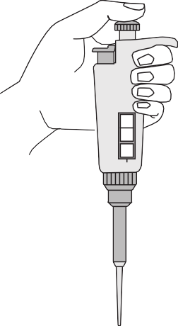
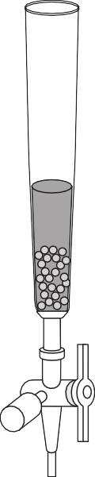
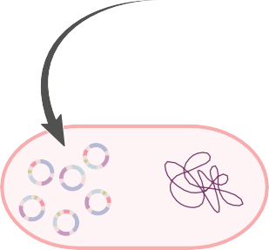



Abridged Genetic Engineering Sequence
Foundations of Biotech:
(16–18 class sessions)
Make Recombinant Plasmid
Use ligase to make recombinant plasmid from DNA fragments.
Verify
e
d
d
i
v
o
r
s
p
Visualize digestion products using gel electrophoresis.
d
i
i
s
m
a
l
d
e p
a
m
-
e
r
A
p
Isolate Gene
➔
+
THE BIG IDEA
Produce Protein
Transform bacteria with recombinant plasmid to produce protein of interest (PoI).
DNA ➔ Protein ➔ Trait
DNA contains all the information needed by organisms to survive and reproduce. The information in DNA is translated into proteins, which contribute to the traits of an organism. Altered DNA can result in non-functioning proteins and can lead to genetic disease. Biotechnology research and development can provide functional proteins to patients and alleviate the symptoms of certain diseases. Through the Foundations of Biotech labs, students will gain hands-on experience in producing a functional protein from genetically modified bacteria.
Use restriction enzymes to digest plasmid and
isolate gene of interest (GoI).
Purify Protein
Use Biotech Tools
Learn how to use biotechnology lab tools.
Grow transformed bacteria and purify PoI through column chromatography.
Verify with Colony PCR
Check for presence of GoI in transformed bacteria using PCR.
Drug Discovery
Research and Development
Manufacturing
Legal Issues
Clinical
Regulatory
Patient Use
Biotechnology Drug Discovery and Development Process
www.amgenbiotechexperience.com

Slide 4
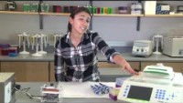
https://youtu.be/HjMPl1J2ZoI

Slide 5
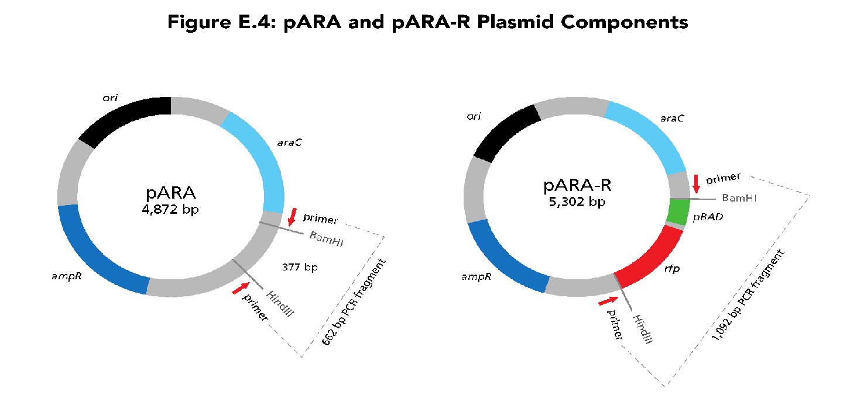
How do you know if you made the desired plasmid?
Will all pink colonies have this plasmid in them?

Slide 6
LAB GOALS
Students will be able to…
  Perform PCR
  Describe applications of PCR
  Explain the role of DNA polymerase and primers in PCR

Slide 7
ORDER OF STUDENT ACTIVITIES
Introduction
What is PCR? (reading)
PCR Laboratory: Using PCR to Amplify the RFP Gene
  Part A: Performing PCR
  Part B: Separate the PCR Products Using Gel Electrophoresis
Analysis Questions
Did You Know?

Slide 8
BACTERIAL TRANSFORMATION = PCR TEMPLATE
Y
LB/Amp/Ara plate

Slide 9
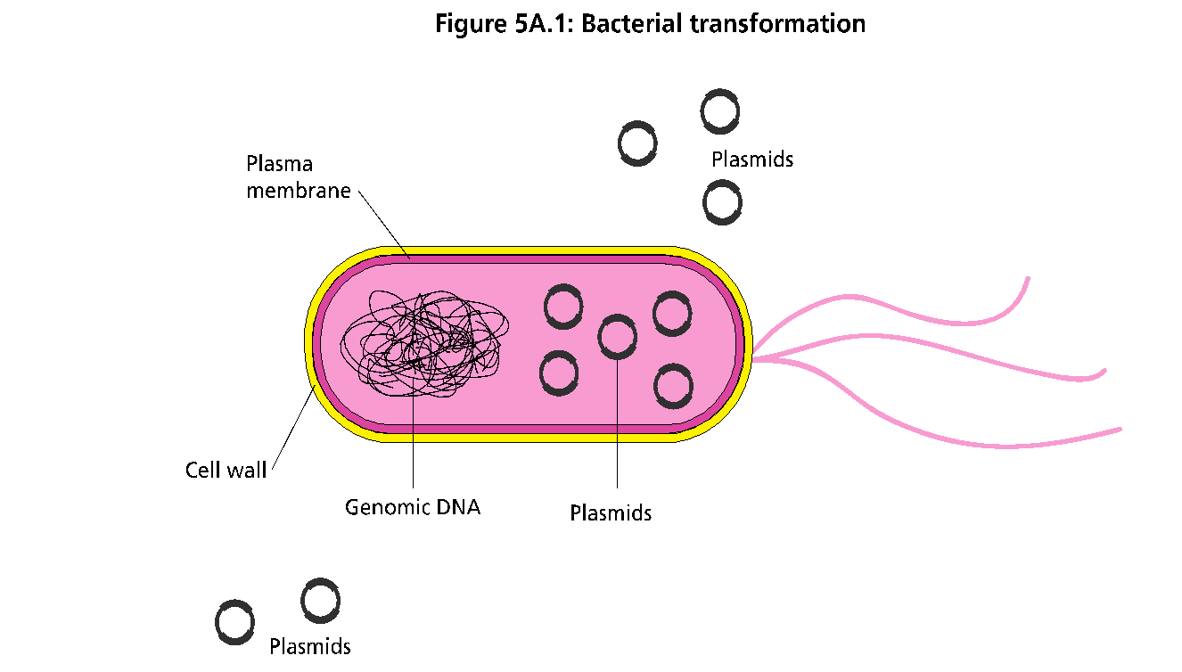
BACTERIAL TRANSFORMATION – PCR TEMPLATE
Y
LB/Amp/Ara plate
Note: Bacteria grow on agar as colonies. A colony originates from a single mother cell, therefore a colony constitutes a clone of bacteria all genetically alike.

Slide 10


BACTERIAL TRANSFORMATION – PCR TEMPLATE
Y
LB/Amp/Ara plate

Slide 11
PART A: PERFORMING PCR
PCR COMPONENTS:
DNA template
Primers: Teachers will add the primers
Buffer (dNTPs, salt Mg²⁺)
Enzyme - Taq DNA polymerase
One Taq from NEB

Slide 12
PCR MASTER MIX
Students receive a tube labeled “PCR”
Contains:
  Primers
  Buffer
  Taq DNA polymerase
YOU MUST PREPARE THIS!

Slide 13
PREPARING PCR TUBES
Each group is aliquoted 100µL
Ratio is 10µL primers to 12.5µL MasterMix (which contains the buffer and enzyme). Can be based on 10µL primers to 13µL Master Mix as well.
Prepare day of the lab.
Use Colony PCR Document provided to determine “recipe”
Thaw primers and MasterMix just before using. Mix immediately and put on wet ice.
Aliquot mixed solution on wet ice and refreeze immediately.
Notes:
Spreadsheet “Primer_MasterMix Calculations”; Info also in aliquoting guide.

Slide 14
Calculations
If you have 12 student groups running four samples each for the ABE Colony PCR lab, you will need to run a total of 48 samples. We suggest that when you make the primer + Taq solution, you increase the sample number for extra volume.
For example: If you have 48 samples, add at least four samples to account for errors, so use 54 to calculate volumes.
54 samples x 10 µL/sample for primer = 540 µL of ABE Colony Primer
54 samples x 13 µL/sample = 702 µL of NEB OneTaq quick load (Labeled TAQ). Note this Taq solution contains the buffers and nucleotides as well as the Taq enzyme.
Each student group will need at least 92 µL of this primer + TAQ mix (labeled PCR)to run four PCR. Students will aliquot 23 µL to each tube (4 tubes @ 23 µL=92 µL)

Slide 15
PLASMID CONTROLS
Negative control
White colony
PCR product = 662 bp
Positive control
Red/pink colony
PCR product = 1,092 bp
Notes:
FOR REVIEW:
Molecular Cell Biology. 4th edition.
Section 7.1DNA Cloning with Plasmid Vectors
http://www.ncbi.nlm.nih.gov/books/NBK21498/#A1583

Slide 16
SETTING UP THE PCR
Obtain cup of ice with reagents. Keep everything chilled.
  PCR = PCR MasterMix
  + = pARA-R positive control plasmid
  - = pARA negative control plasmid

Slide 17
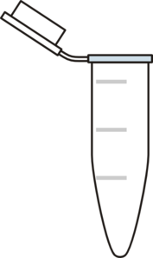
SETTING UP THE PCR – CONTINUED
Review table, label 4 PCR tubes and place in rack
Add 23µL PCR MasterMix to each tube ON ICE
Label side of PCR tubes with initials
1 AG RC 2 AG WC 3 AG P+ 4 AG P-

Slide 18
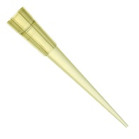
LB/Amp/Ara plate
Put glove on dominant hand
Pick a single bacterial colony with pipette tip (avoid agar)
Transfer colony to PCR tube by swirling in the MM on ice
Plasmid Tubes
pARA-R: (+) control
pARA: (-) control
Use P20 or P10 pipette to add 2uL of each plasmid to PCR tube
Gently pipet up and down to mix
Keep on ice
+ 2ul pARA-R
+ 2ul
pARA
+ red colony
+ white colony
1 AG P+ 2 AG P-
1 AG RC 2 AG WC -

Slide 19
SETTING UP THE PCR – CONT.
Tap or centrifuge PCR tubes to make sure all contents (25µL total) are at the bottom of the tube
Bring tubes ON ICE to the teacher to be put in the PCR machine

Slide 20
THINK-PAIR-SHARE
ANSWER AS YOUR STUDENTS
What is PCR?
Why do we use PCR?
Notes:
Have teachers answer as students based on what they already know from this activity/reading or what they would have already learned in their class.

Slide 21
WHAT IS PCR?
Polymerase Chain Reaction
Widely used molecular biology technique/method
Makes billions of copies of a specific DNA sequence
Invented by Kary Mullis in 1983
Has three main phases which are repeated many times

Slide 22
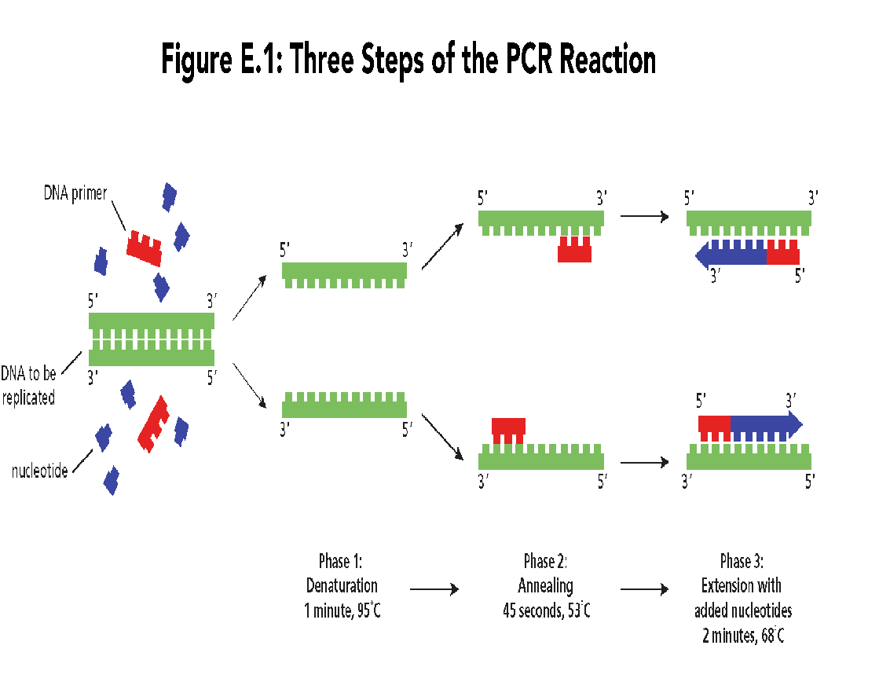
DENATURATION
High temp (e.g. 95-96° C) causes hydrogen bonds between bases in double stranded DNA template to break
Notes:
Diagram in SB pg E-3

Slide 23

ANNEALING
Lower temp (e.g. 53° C) allows primers to bind to complementary sites on single stranded template
Notes:
Diagram in SB pg E-3

Slide 24
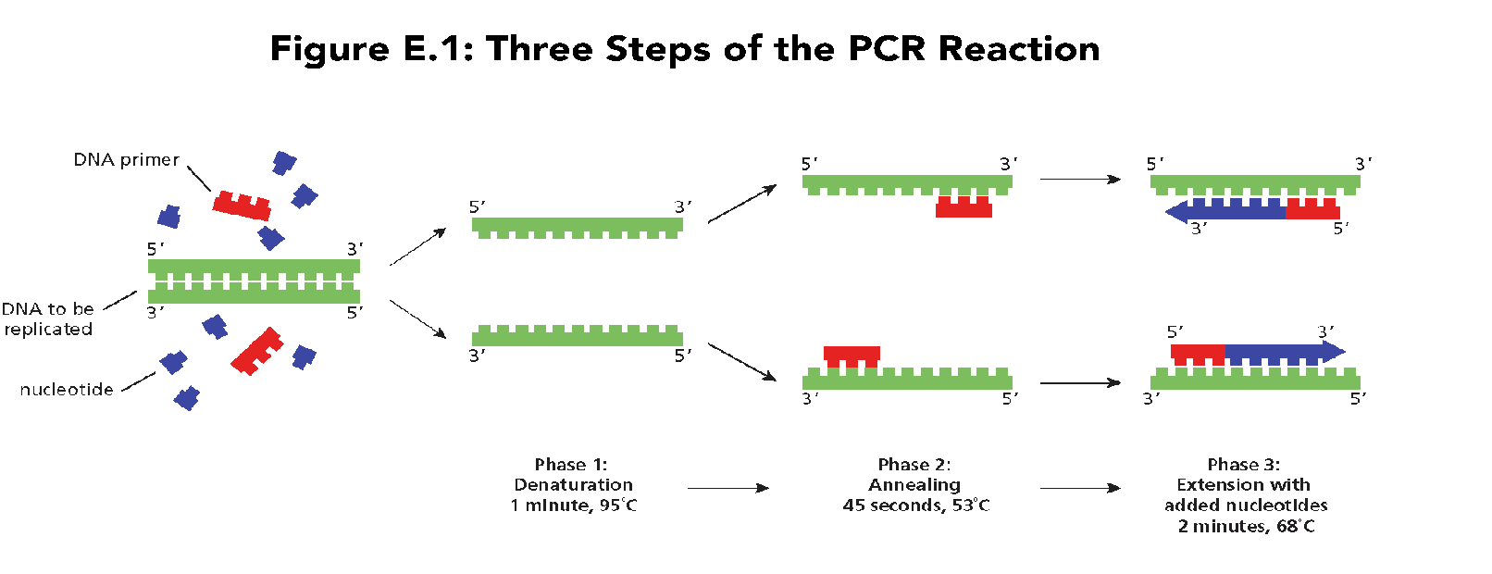
EXTENSION (ELONGATION)
Temp raised to optimal temp for DNA polymerase to synthesize new complementary strand (e.g. 68° C)
Notes:
Diagram in SB pg E-3

Slide 25
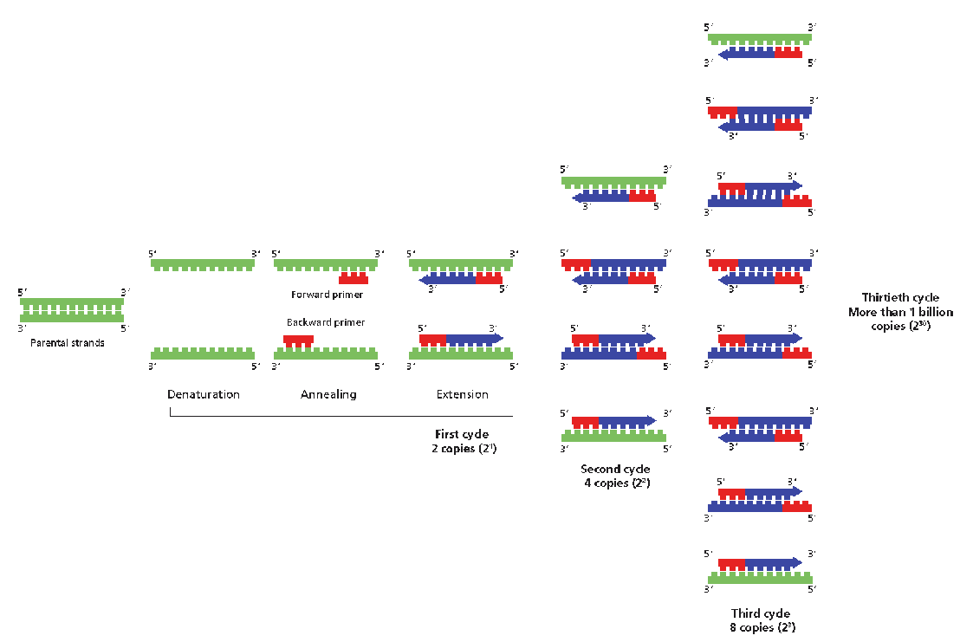
DNA AMPLIFICATION OCCURS OVER MANY CYCLES

Slide 26
How many cycles until you have ONE double stranded copy of the specific sequence of interest?
# cycles?

Slide 27
How many cycles until you have ONE double stranded copy of the specific sequence of interest?
# cycles?
Notes:
At the end of the third cycle you get two copies of the double stranded specific sequence of interest at the desired length (copies come in even numbers, never just one)

Slide 28
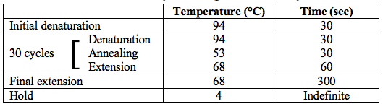
COLONY PCR
How many copies of our sequence of interest will we have after 30 cycles?

Slide 29
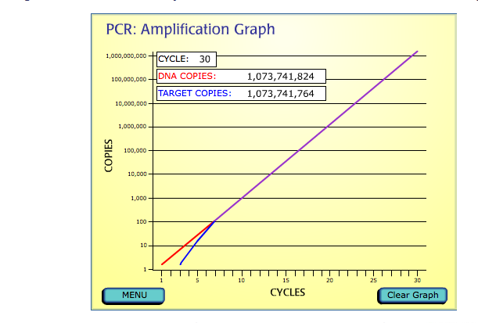
PCR produces ~1 billion copies of the targeted DNA sequence in 30 cycles

Slide 30
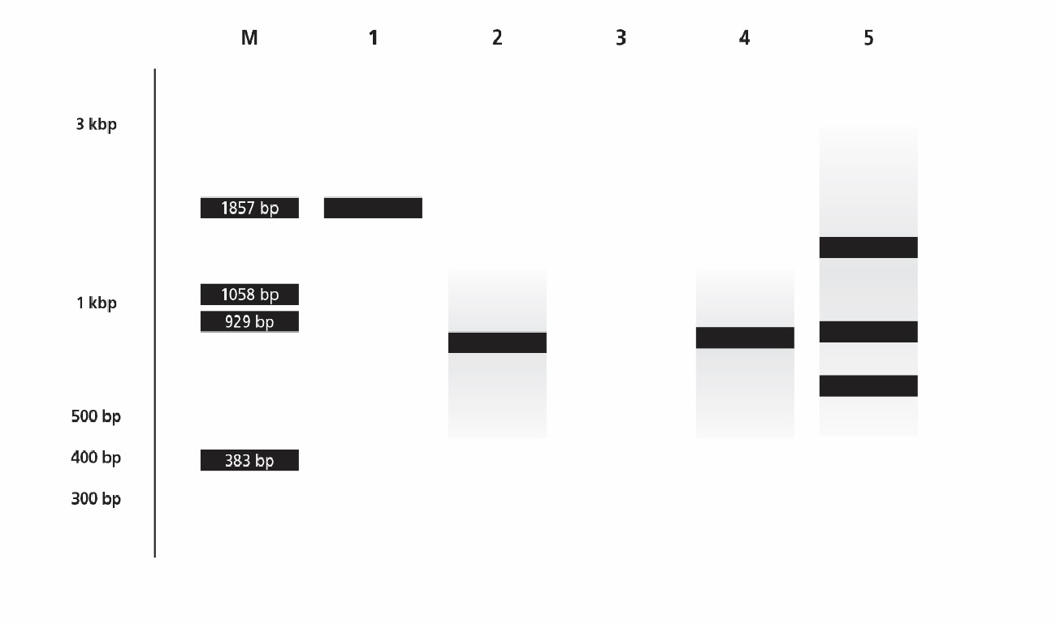
PART B: SEPARATE PCR PRODUCTS USING GEL ELECTROPHORESIS
Successful reaction:
Product has been made
Product is the expected length
Only one product synthesized
X
X
Notes:
Sample diagram/gel from SB pg E-5. NOT predicted results for our gels! Lane 5: Degenerate primers cause spurious amplification (best biotech phrase ever!).

Slide 31
PLASMID COMPONENTS
Negative control
White colony
PCR product = 662 bp
Positive control
Red/pink colony
PCR product = 1,092 bp
Notes:
FOR REVIEW:
Molecular Cell Biology. 4th edition.
Section 7.1DNA Cloning with Plasmid Vectors
http://www.ncbi.nlm.nih.gov/books/NBK21498/#A1583

Slide 32
PART B: PROCEDURE
Collect 4 PCR tubes from Part A
Load 10µL of each sample in gel*
Load 10µL of DNA ladder (M)
Run gel at 100-130 volts until dark blue dye is halfway down gel ( ~ 30 min)
1 DNA Ladder (M)
2 Red colony
3 White Colony
4 pARA-R (+)
5 pARA (-)
Predict Your Results

Slide 33
GEL RESULTS
Successful reaction:
Product has been made
Product is the expected length
Only one product synthesized
X
X
Notes:
Sample diagram/gel from SB pg E-5. NOT predicted results for our gels!

Slide 34
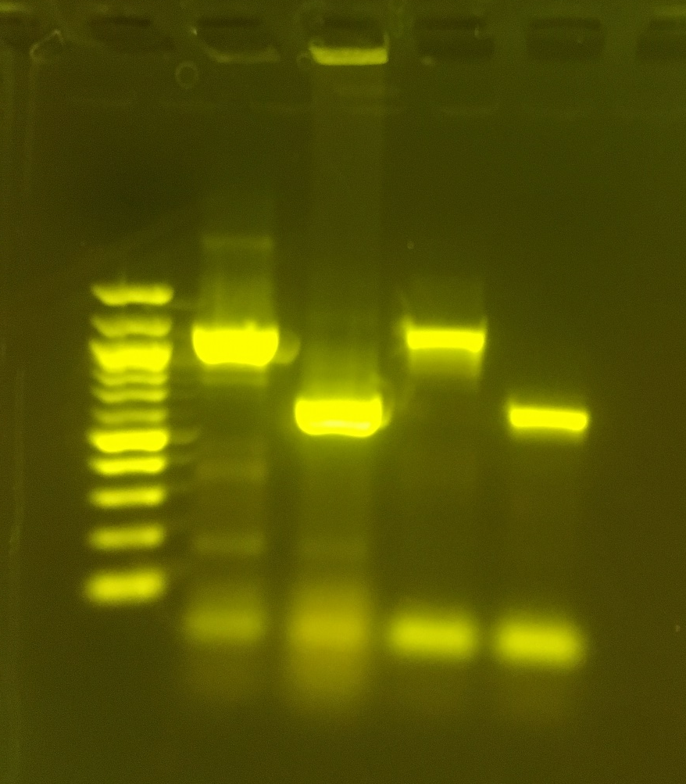
DNA Ladder
Red colony
White Colony
pARA-R (+)
pARA (-)
Expected or unexpected results?
Notes:
In this gel the third (middle) lane does not have a band where there should be for the white colony. Possibly due to plucking a satellite colony, or because the reaction didn’t work (for any number of reasons). All four reaction lanes show primer dimers at the bottom. Middle lane shows two bands of dimers, possibly because without the larger DNA fragment from the white colony the reaction was able to make a much higher concentration of primer dimers.

Slide 35
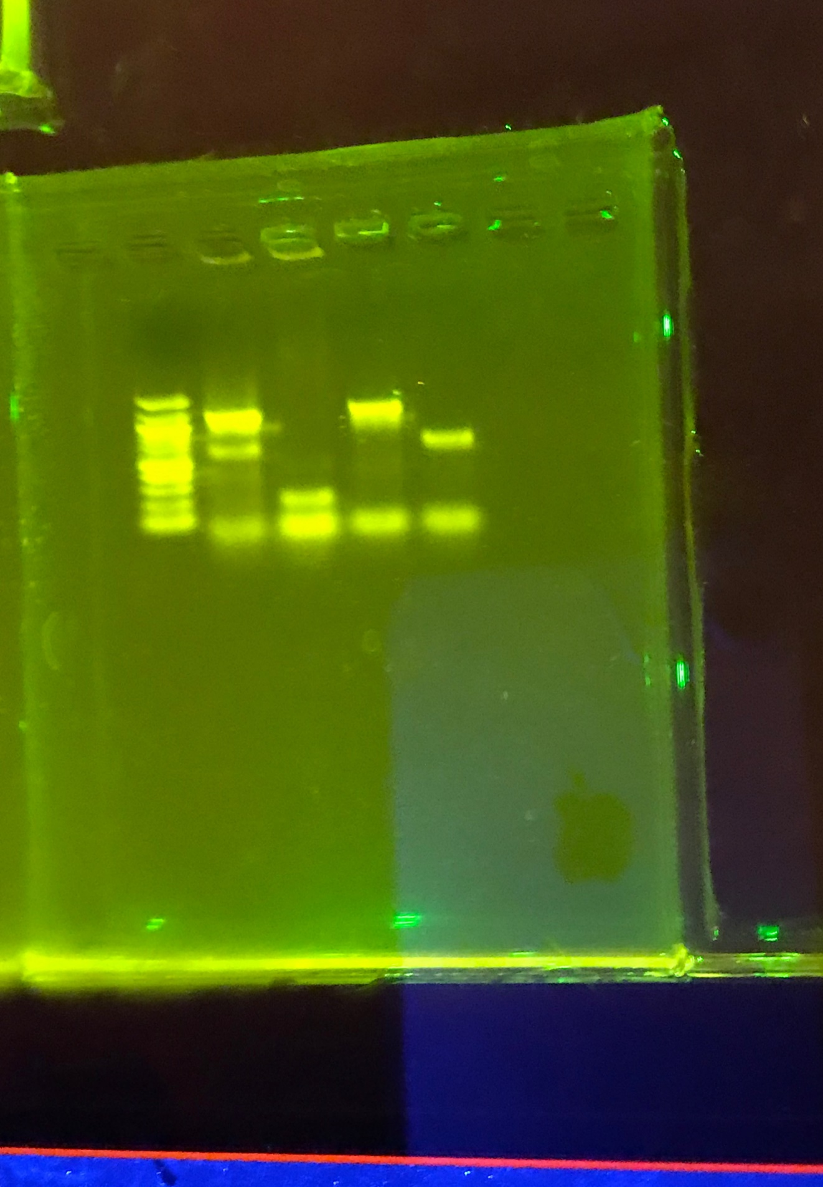
DNA Ladder
Red colony
White Colony
pARA-R (+)
pARA (-)
The third (middle) lane does not have a band where there should be for the white colony. Possibly due to plucking a satellite colony, or because the reaction didn’t work.
All four reaction lanes show primer dimers at the bottom. Middle lane shows two bands of dimers, possibly because without the larger DNA fragment from the white colony the reaction was able to make a much higher concentration of primer dimers.
Notes:
In this gel the third (middle) lane does not have a band where there should be for the white colony. Possibly due to plucking a satellite colony, or because the reaction didn’t work (for any number of reasons). All four reaction lanes show primer dimers at the bottom. Middle lane shows two bands of dimers, possibly because without the larger DNA fragment from the white colony the reaction was able to make a much higher concentration of primer dimers.

Slide 36
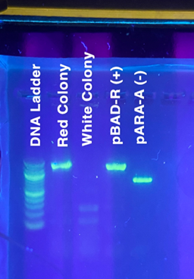
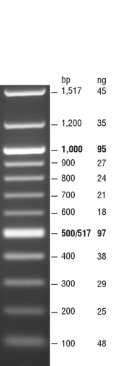
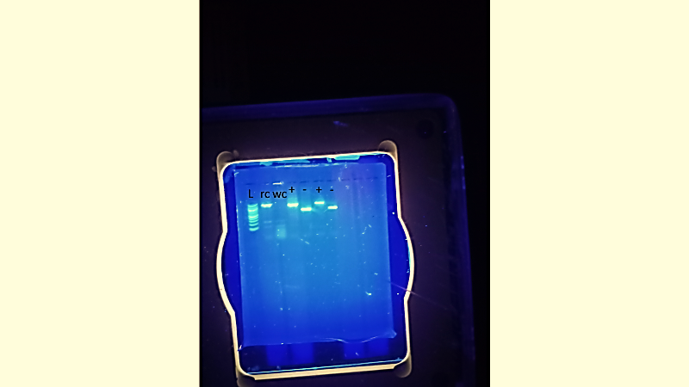
Lane 1: 100bp ladder
Lane 2: Red/pink colony
Lane 3: White colony
Lane 4: pAra-R (pBad) Positive control (1092bp)
Lane 5:pAra-A Negative control (662 bp)
Lane 1: 100bp ladder
Lane 2: Red/pink colony
Lane 3: White colony
Lane 4/6: pAra-R (pBad) Positive control (1092bp)
Lane 5/7:pAra-A Negative control (662 bp)
0.8% Agarose, 130V for 30 min

Slide 37
WHY IS COLONY PCR IMPORTANT?
In research usually not working with different colored bacteria
Ligations result in multiple plasmid products, need to distinguish between them
Quick way to determine which plasmid you have (or which you want) before continuing research

Slide 38
COLONY PCR TIPS
Not in Kit:
  bottles for 1X buffer
  glassware
  gloves
Different/not in Teacher Guide:
  Don’t let plates incubate too long (risk of satellite colonies)
  Thaw MM & primers then immediately put on wet ice. Keep on wet ice as you mix/aliquot

Slide 39
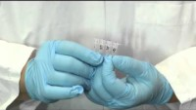
COLONY VIDEO RESOURCES
Colony PCR Overview
https://youtu.be/L9ZIMy96v-Q

Slide 40
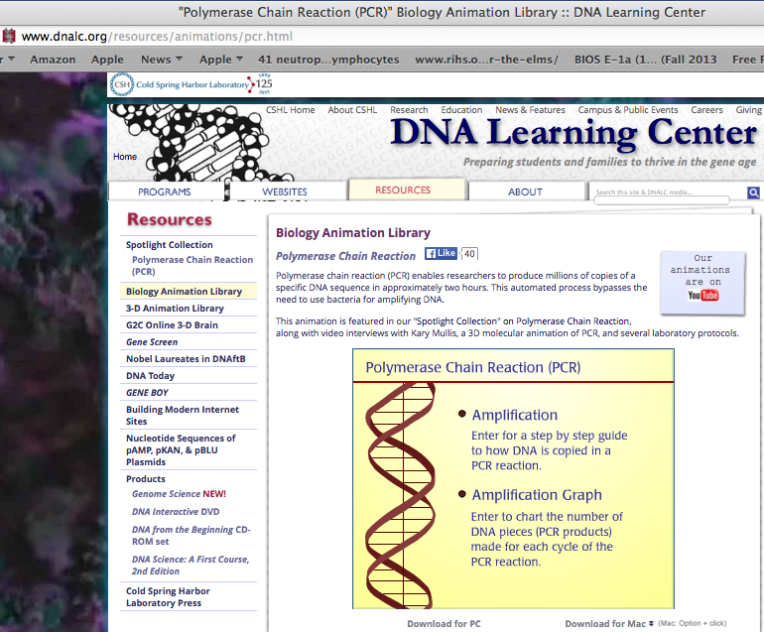
ADDITIONAL RESOURCES
LabXchange Colony PCR
Colony PCR
https://www.labxchange.org/library/pathway/lx-pathway:9d767909-26ba-4430-9f60-3830284bc31f
LabXchange: Assets for Foundations of Biotech Labs
https://www.dnalc.org/resources/animations/pcr.html

